Slide 1
Beazley gpas and Billing OPERATING MODEL
Ways of Working for GPAS Programme Delivery – DRAFT
Draft: July 2024

Slide 2
CONTEXT
Ways of working is a Capgemini recommended way of Program execution allowing all relevant parties and stakeholders to operate and collaborate towards achieving the common program goals. This document intends to target both processes and behaviours that form the building blocks of successful completion of GPAS
This Ways of working is specifically designed for GPAS and Billing scope of work only and for the scope of work owned by Capgemini. The processes, behaviours and recommendations outlined here may not be applicable outside GPAS to the wider Modernization program
The Ways of working document is expected to evolve iteratively, through Inception phase before it can be made final. However, throughout the GPAS program execution, the delivery method or process may undergo change in certain sections if all the influenced parties agree there is a need for improvement

Slide 3
Ways of working
The immediate focus is to draft and agree on Ways of working applicable for the start of Inception phase covering activities, deliverables, methods and processes expected to be jointly built and done by Capgemini and Beazley. As a next step, this document will be extended to document methods and processes applicable to the Build phase.
To be built & agreed for start of Inception
INCEPTION PHASE
Scope of Inception phase
Key Success factors
Inception activities – week wise split
Workshops – rules of engagement
Inception phase deliverables
Team Structure for Inception
Design Principles
RACI
Key roles – Beazley and Capgemini
Governance – Key roles, Cadence, Escalation, Change Control
Tools for Inception
JIRA set-up and governance
Build
Phase
Build Phase
Sprint Timeline, Ceremonies, Reporting
Standard Development Team Composition
User story composition, Elaboration Cycle
Cadence, Sprint Events RACI
Scrum of Scrums, Retrospectives
User Story Management – Different Scenarios
Activities List – Elaboration, Design & Dev
A Day in a life during Sprint Development
DoD and DoR – User story & Sprint
Working with Guidewire – 3 way collaboration
Testing – Scope, Strategy, Governance, Activities, and Schedule
Third party dependency management
Sprint Progress tracking
Sprint Closure report

Slide 4
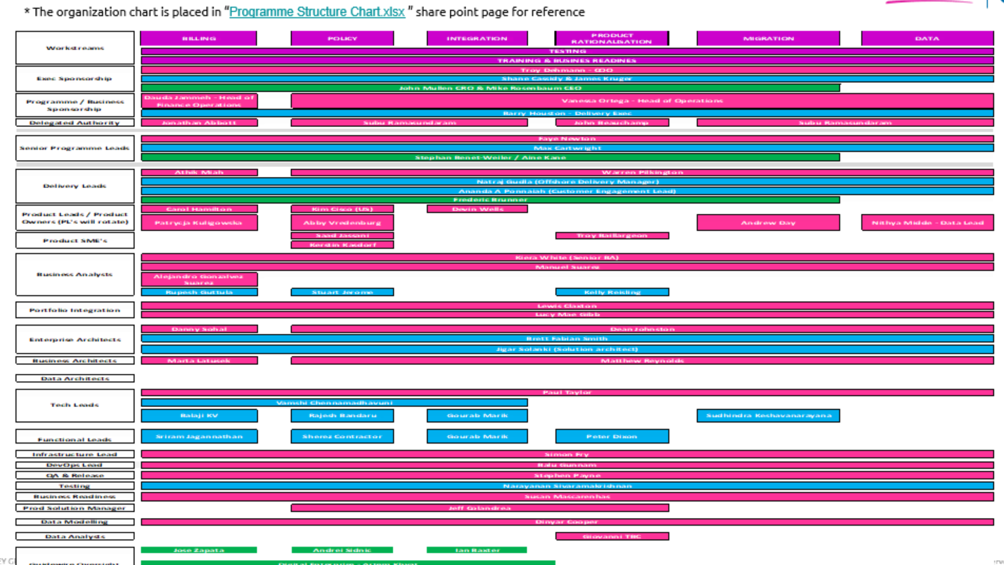
GPAS & BILLING MODERNISATION ORGANISATION CHART

Slide 5
GPAS & Billing PROGRAM Release Trains
BILLING (Guidewire)
Responsible to implement the new Policy system in Guidewire across all Beazley Product variations & Lines of Business in Scope
MIGRATION
Responsible to provision all Infrastructure & Environments for a smooth Program execution e.g. Citrix machines, Scalable Dev, Test and Prod environments, DevOps support for continuous deployments & testing.
PROGRAM MANAGEMENT
LEGACY
Responsible for Overall Program Governance that includes Planning, Monitoring execution to Budget, Mitigate Risks & Issues.
Responsible to validate & sign-off Finance systems to the new GPAS & Billing implementation
Responsible to support Data Migration Release train enabling smooth migration of all Legacy Policy records into the new system
FINANCE
Responsible to implement the new Billing system in Guidewire to handle Billing cycle of all new Policies to be initiated under the new Policy system
POLICY (Guidewire)
INTEGRATION
Responsible to implement the in-scope integration elements necessary to ensure Guidewire operates as per business requirements.
Responsible to Build Data analytics on top of GPAS & Billing data meeting Business needs.
DOCS TOOLING
Responsible to implement all necessary communications to support Beazley’s business requirements.
TRAINING & BUSINESS READINESS
Responsible to Design and Roll out the new system to Business users, handle training, comms, stakeholder Mgmnt., risks and issue mitigation.
ARCHITECTURE
PRODUCT RATIONALISATION
Responsible to Rationalise product set for Foundation release and agree a framework for rationalising the remaining GPAS Products.
Responsible to Migrate all Legacy Policy data at renewal into the new Guidewire system.
TESTING
Responsible to make sure we are deploying code to production that meets Business requirements & Program and Product quality standards
DATA
BUSINESS DESIGN
Responsible to create a centre of excellence for Beazley E2E process and journey design, ensuring consistency and quality.
Responsible to create a System Architecture for the Program that is Robust, Industry standard, Scalable and meets Beazley’s requirements
ENVIRONMENTS & INFRASTRUCTURE
Key:
Defined Release trains/Teams
TBC Release trains/Teams

Slide 6

INCEPTION PHASE HELPS TO CREATE THE FOUNDATION AND VISION FOR THE TRANSFORMATION
A common 12-weeks Programme Inception phase to clarify and align the scope in all Products for a Foundation,
followed by the implementation of the planned Releases.
Programme Inception
Design and Build
Programme Inception is focused on “Designing the next winning proposition”
Foundation Release Mobilization is focused on enabling MVP Design and Build to start
Build the foundation with core principles intact. – data/ automation / experience
Collaborative pre-work on entry criteria to ensure rapid start and timely completion
Transform the plan from the Inception to reality, transforming the business requirements to functional systems
Plan for future Releases and LOB
Confirm Roll-out Approach
Key Design Decisions log
What you’ll get:
Prioritized backlog
High Level Design
Foundation release plan
Key risks & assumptions
Dependencies detailed

Slide 7

KEY SUCCESS FACTORS
Right Time
  Multi-day sessions
  Aligned workshops
  Covering India, UK and US time zone
Outputs more focused at Foundation release
GPAS Ways of working
Prioritized Backlog
Effort & Resourcing
GPAS & Billing HLD and Delivery Plan
LLD for Initial build phase
Key Design Decisions
Migration Strategy
Integration Inventory
Dependency tracker
Test Strategy
Rationalized Product set
Foundation Release Plan
Pebbles / Rocks / Boulders
Categorizing elements of solution for appropriate escalation to finalise scope
Right Inputs
  Product / Process Design
  OOTB Guidewire Process Flows
  Interfaces
COLLABORATION
AGILE
MATURITY
Right Team
  Product Owners, Business SME
  Right Capgemini team
  Collaboration is key
DEPENDENCIES MANAGEMENT
Right Enablers
  Guidewire Instance
  Collab Tools
  Reliable access to VDIs
Right Decisions
  Timely & accurate decisions
  On time escalations for help
  Lean thinking
Inception Phase Principles
OOTB Conformance
Business Priority / Rationale
Design for Future

Slide 8
Design principles
All key decisions to move through formal programme governance decision bodies
Does the decision?:
Decision making process:
Support the agreed Release scope
Ensure the business is not in a worse position from before
Allow for scalability and is not closed off for future-states
Conform to Beazley architectural principles
Support a move off existing systems
Support flexibility and maintainability for future releases
Complies to Beazley's Information Security requirements
Workshop/Meeting where key question arises
Identification of key decision needed, decision owner and required inputs to enable decision
Creation of key decision paper and supporting material(s)
If required and necessary - Review & Validation of Impact with Specific working Groups within Beazley – Example Finance Design Group
Presentation at BDA/TDA or both as required
BDA/TDA decision output documented and stored
Ratification of BDA/TDA decision output at Programme Leadership/Steering if required

Slide 9




Guidelines for meetings and workshops
Rules of Engagement
  All meeting and workshop invites to include:
    Purpose of the meeting / Agenda
    Input to the meeting
    Expected output from the meeting
    Deliverable(s) output (as required)
  Business attendees and availability to be confirmed by Beazley (Senior Product Owner/relevant Product Owner) before invitation is sent
  Parking lots/Decision logs to be captured and logged in the required trackers
  Critical decisions to go through appropriate Programme Governance forums and documentation
  On site and remote attendance options to be available
  Recording of sessions to be used where appropriate
  All sessions to be aligned to overall programme strategy
  All material to be utilised for Beazley programme purposes only

Slide 10
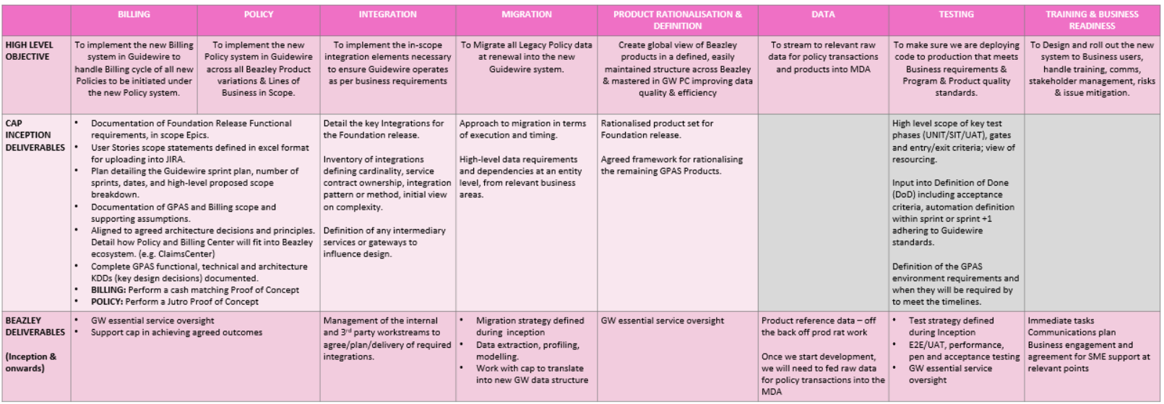
HIGH LEVEL SCOPE Elements
The entries here are high-level and the initial understanding of the scope between different parties. Through the Elaboration phase all scope items will be discussed, expanded and requirement boundaries defined. The Prioritised backlog, Detailed Dependency tracker Inception deliverables that Capgemini will produce will detail the final scope for Foundation release (specific to Policy, Billing, Integration, Migration and Product Rationalization) and call out dependencies amongst different parties.

Slide 11
Inception programme deliverable outputs
Deliverables at programme level & expected signatories
Deliverables to be produced during Inception, ready for review and response feedback loop. All deliverables to have a wider review distribution which will be confirmed on the deliverable itself.
Functional Activities
Obtain an understanding of in scope functional areas
Obtain and understanding of as is current processes
Receive demos of current systems
Review the existing capability map and identify any gaps
Deliverable Names | High level Description and Expectation | Review | Sign Off
PD1: GPAS Ways of Working | Detailed methodology, Governance model, Change control model, communication management, Reporting & meeting cadence, Initial team structure, RACI, Escalation approach, Tools for build & usage boundaries | Core GPAS Team | Steering Group GPAS/Billing
PD2: Prioritized Backlog (Foundation) | Documentation of Foundation Release Functional requirements, in scope Epics/Features. User Stories scope statement defined in excel format for uploading into JIRA | Core GPAS Team | Product Owners
PD3: Resourcing & Efforts (Foundation) | Breakdown of resourcing needs (by quarter) aligned to effort and bottom-up estimation of Epics and Features against the delivery plan. High level scope, budget, and resourcing/effort should reconcile. | Core GPAS Team | Delivery Leads
PD4: Delivery Structure & Plan (Foundation) | Phase & Release train definitions, objectives and milestones. Verification and Acceptance. Plan detailing the Guidewire sprint plan, number of sprints, dates, and high-level proposed scope breakdown. | Core GPAS Team | Delivery Leads
PD5: GPAS High Level Design | Aligned to agreed architecture decisions and principles Detail how Policy and Billing Center will fit into Beazley ecosystem. Detail the key Integrations for the Foundation release | Core GPAS Team | Enterprise Architects
PD6: Migration Strategy | Approach to migration in terms of execution and timing. High-level data requirements at an entity level, from relevant business areas. | GPAS Steering Group | Strategic Design Authority
PD7: Integration Manifest | Inventory of integrations defining cardinality, service contract ownership, integration pattern or method, initial view on complexity. Definition of any intermediated services or gateways to influence design. | Product Owners Integration Lead | Enterprise Architects

Slide 12
Inception programme deliverable outputs
Deliverables at programme level & expected signatories
Functional Activities
Obtain an understanding of in scope functional areas
Obtain and understanding of as is current processes
Receive demos of current systems
Review the existing capability map and identify any gaps
Deliverables to be produced during Inception, ready for review and response feedback loop. All deliverables to have a wider review distribution which will be confirmed on the deliverable itself
Deliverable Names | High level Description and Expectation | Reviewer | Sign Off
PD8: Detailed Dependency Tracker | Internal and External Dependencies detailed with dates and deliverables agreed with each of the related parties. | Core GPAS Team | Delivery Leads
PD9: Functional & Technical Principals | Functional and Technical Design principles documented. | Core GPAS Team | Delivery Leads
PD10: GPAS Test Strategy | High level scope of key test phases, gates and entry/exit criteria; view of resourcing. Input into Definition of Done (DoD) including acceptance criteria, automation definition. Definition of the GPAS environment requirements and when they will be required by to meet the timelines. | QA Lead Core GPAS Team | Delivery Leads
PD11: Product Set | Rationalised product set for foundation release Identification of any products requiring further analysis and key decision papers where necessary. | Core GPAS Team Product Definition Release train (UW) | Strategic Design Authority
PD12: Perform a Jutro Proof of Concept. | Walkthrough of PoC which should demonstrate the applicability of Jutro to Build out UWWB screens. Options paper detailing the pros/cons of Jutro approach vs building it out in UWWb. | Reviewed and Agreed with Beazley EA (GPAS & Billing) | Beazley EA
PD13: Perform a cash matching Proof of Concept for Billing | Walkthrough of PoC which should demonstrate that cash matching requirements can (or cannot) be assigned from backlog | Reviewed and Agreed with Beazley PO (Billing) | Product Owner (Billing)
To maximize efficiency and protect our plans, we will work with a ‘2 review plus sign off’ approach to deliverable sign off. Initial review (3 working days), second review (2 working days) and sign off (1 working day). Expectation is that the second review includes feedback from 1st review updates only. A tracker will be used to help track and manage progress. This sign-off approach will be followed for other areas like Test Strategy, Test Scenarios, Migration Plan and similar documents or approaches that need Beazley sign-off throughout the Program duration.

Slide 13
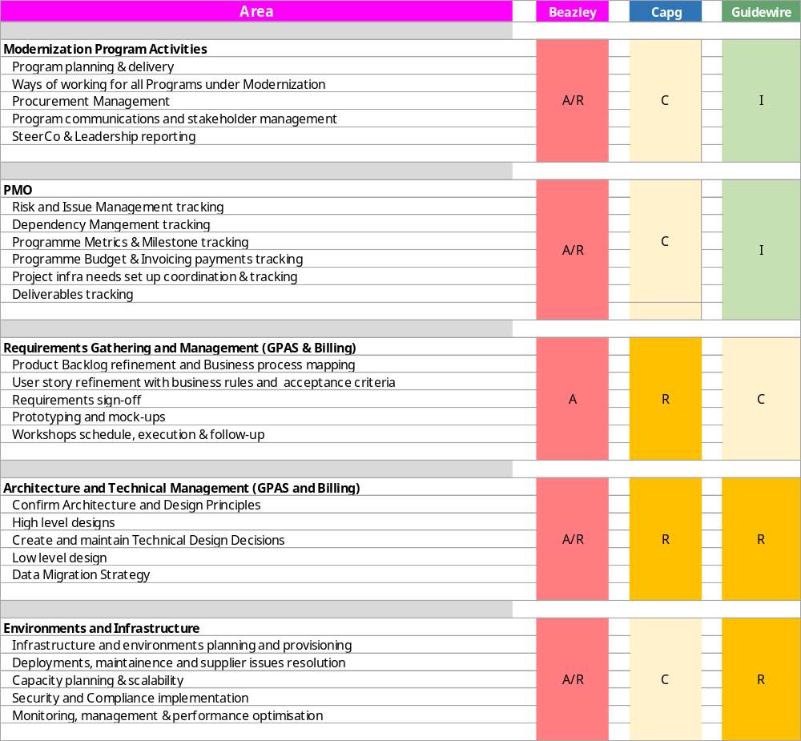
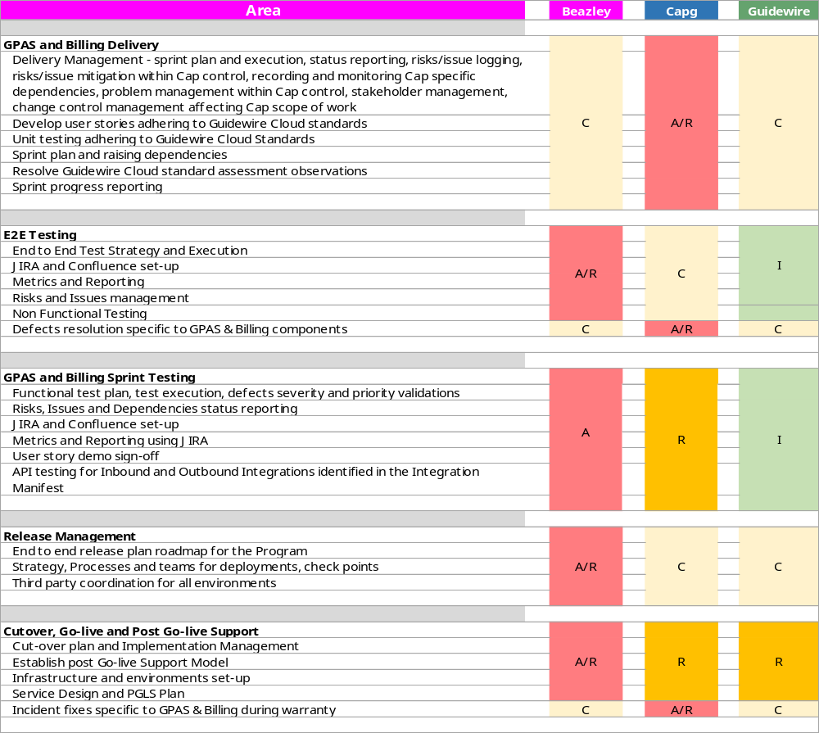
KEY AREAS – raci [1]
Key
** In-Sprint Integration testing - Integrations finalized in the Integration Manifest, will need to arrive at the sprint schedule in line with the sprint plan. Any deviations to this will need to be impact assessed. If these deviations can be accommodated without impacting the overall in-sprint testing schedule, Capgemini will seek to accommodate them, however, this cannot be guaranteed
A | Accountable | Authority and decision making
R | Responsible | Responsible for actualisation of the task
C | Consulted | Engaged stakeholder, consulted in decisions, delivery and approach to enable their input
I | Informed | Informed stakeholder receiving updates and outputs only

Slide 14
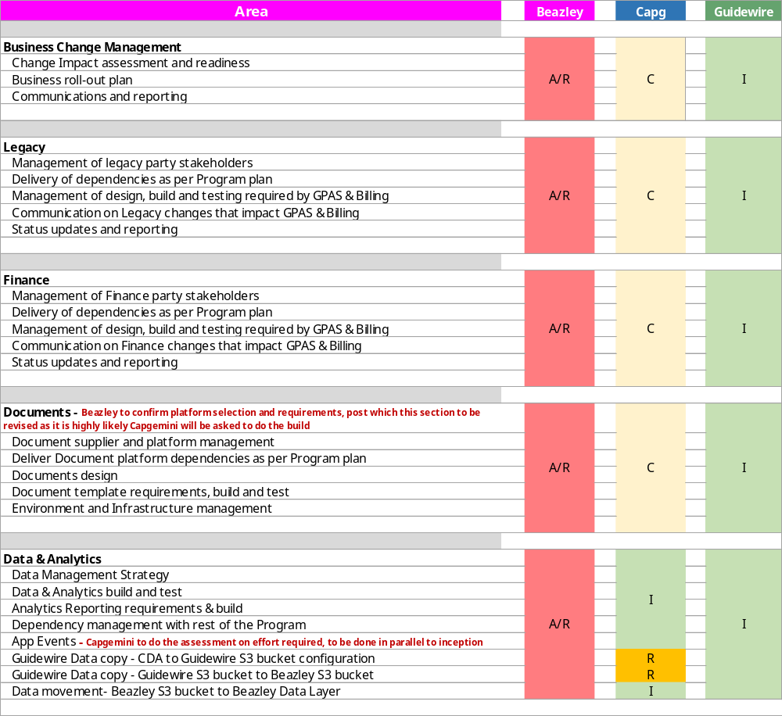
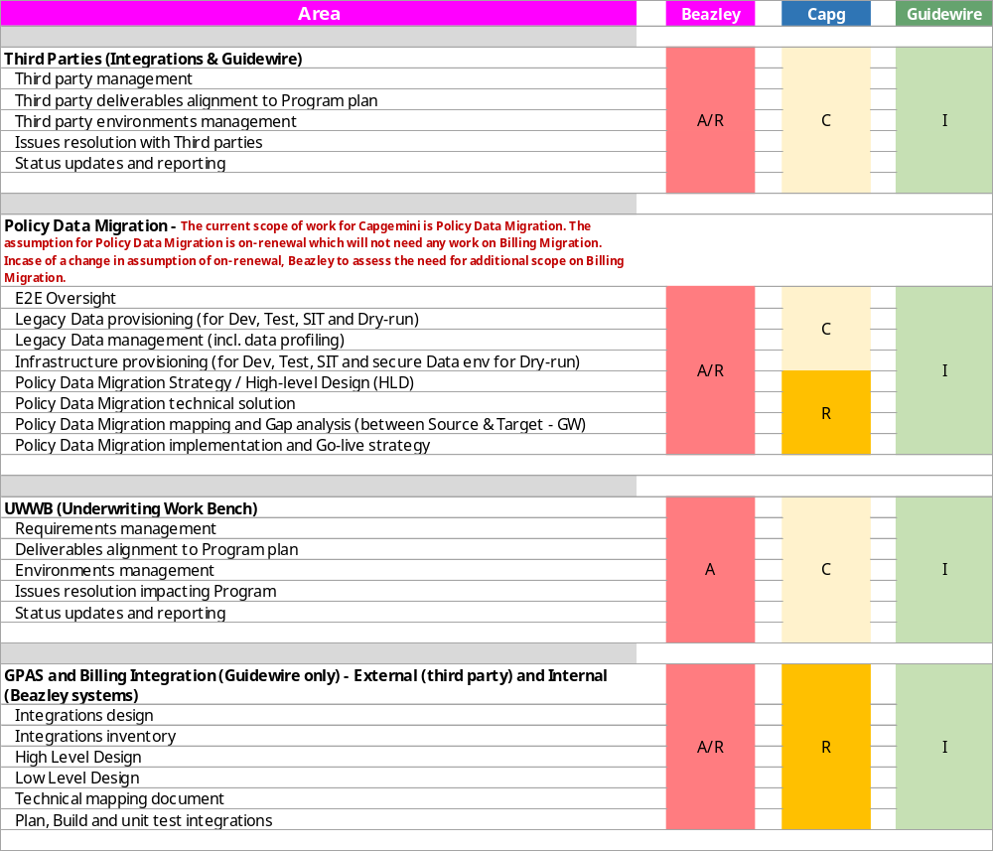
KEY AREAS – raci [2]
Key
A | Accountable | Authority and decision making
R | Responsible | Responsible for actualisation of the task
C | Consulted | Engaged stakeholder, consulted in decisions, delivery and approach to enable their input
I | Informed | Informed stakeholder receiving updates and outputs only

Slide 15
KEY ROLES – Beazley
Role | Named Resource | Responsibilities
Business Owner/ Sponsor | Vanessa Ortega Dauda Jammeh | Ensure alignment to overall Modernisation/Beazley strategic goals Drive senior accountability across the programme Approve scope, target design and execution plans for the PAS initiative. Accountable for delivery against OKRs, business outcomes and benefit realisation. Commits or helps facilitate appropriate resources (e.g. SMEs) and support issue resolution for the PAS initiative. Approve and oversee key initiative decisions as adviser Steer solution design and build based on business needs Drive agreement of dependencies at sponsorship/exec level, if required. Approvals (or noting) of vendor outcomes/deliverables
Program Director | Faye Newton | Be the Single point of Ownership from Beazley on the Program Program Manage execution of the GPAS & Billing Business requirements Mitigate Program Risks and Issues from time to time Provide leadership and Direction to motivate teams towards successful program completion Collaborate with involved stakeholders for success of the Program Responsible for overall Services quality and delivery of the Program
PAS Delivery Lead / Billing Delivery Lead | Warren Pilkington Athik Miah | Develop the initiative objectives, scope, high-level implementation roadmap, resource requirements and investment estimates. Working with the delivery partners, create and manage the PAS delivery plans. Manage the delivery teams inc. resource management, supply & demand, technical capability and skills Manage inbound and outbound dependencies needed for the delivery of the component Management of risks and issues impacting progress Responsible for status reporting of the project Lead by example, driving the right behaviours across the programme
Senior Technical Partners / Business Leads | Jonathan Abbot | Provide holistic business/technical expertise and oversight for their workstream/Programme Have delegated authority to make decisions on Sponsors behalf for their relevant workstream Aligns with other Senior Leads/relevant SMEs to assess and understand impact of risks/issues/decisions/dependencies. Attends exec leadership level governance forums and leadership/delivery forums as required Lead by example, driving the right behaviours across the programme
Architecture | Danny Sobal (Finance EA) Marta Latuszek (Billing Business) | Work with squads to define target state technical solutions, identify technology requirements Gain approval through Design Authority for technical solutions including any security compliance Identify and monitor architecture & design technical risks and dependencies, oversee necessary mitigation controls Assurance of HLD and LLD solution designs with CAP Architects for GPAS Delivery of HLD/LLD solution designs for Beazley dependent elements of the overall solution design Work with Release train teams to: Define architectural backlog and technical guardrails Provide the necessary Inputs to groom the Backlog and Sprint/PI Planning Ensure architecture compliance with agreed SDLC and Beazley standards Manage Version Control of architecture related components Identify dependencies and risks affecting architecture & design

Slide 16
KEY ROLES – Beazley
Role | Named Resource | Responsibilities
Global PAS Technical/Functional Lead | Jeff Colandrea | Helps define the PAS Product Strategy, Vision and Roadmaps alongside the Product Owners in the PAS initiative. Managing and prioritizing the PAS Portfolio Backlog taking care to ensure alignment with business architecture, data teams and existing BAU environments. Delivering Value by ensuring the PAS solutions are complete from the user perspective (including operations, change etc.) and deliver meaningful business value. Point of escalation and coaching for squad-level Product Owners.
Product Owners | Carol Hamilton (Billing) Patrycja Kuligowska (Billing) Kerstin Kasdorf (Policy) Jeff Colandrea (Prod Rationalization) Stephen Payne (Migration) | There will be different Product Leads depending on the release/wave of PAS implementation. For example, Cyber and D&O in Foundation release. Ensuring that the Product Backlog is visible, transparent & clear to all stakeholders The Product Owner is one voice for their workstream but may represent multiple stakeholders (Operations, Underwriting, Finance and Claims areas) Understand and be able to describe the end-to-end solution in a high level, the use cases and related business drivers. Attend decision making sessions, feeding input regarding the product and its interaction with other components, acting as a point of reference for the product required features and behavior. Understand business demands and requirements and translate these into solutions that are refined iteratively and present them to the team. Understand impact of the E2E process on People, Process, Technology and data Engage with various business areas/initiatives to understand impacts upstream/downstream and within Programme delivery Escalate risks/issues/decisions/dependencies appropriately as per programme governance Ensure that the individual scope items meet the “definition of done” before acceptance. Clear definition and alignment of “definition of done” for scope items Prioritize requirements of the product and make adjustments as needed after each release. Define the future goal of the product (the ‘product vision’) Aligns/collaborates with other workstream Product Owners to drive right outcome for programme Maintain and own the product backlog. Accepting or rejecting suggested improvements. Report progress, involvement in governance arrangements. Accountable for traceability of requirements to business outcomes and test scenarios
Change Management Lead | Susan Mascarenhas | Responsible for managing all types of change Evaluates the impact of change Supports development of communications relevant to change initiatives Accountable for defining success metrics and measuring performance against these
Quality Assurance Testing Lead | Nabil Ahsraf (Beazley) Alagiya Nambi Rajappan (Hexaware) | Ultimately accountable for the quality of the overall end to end solution Provides overall QA oversight for test design and execution, striving for commonality where appropriate Accountable for defining Program level test strategies and approaches for all test phases Accountable for planning and oversight of all test phases, including UAT Provides testing oversight and direction, drives execution of testing strategies and manages testing related objectives and issues across the Program
Business Architecture Lead | Subu Ramasundaram (Business Design Framework) Matt Reynolds Marta Latuszek | Accountable for developing the business architecture strategy Applying structured business architecture approach and methodology Drives and facilitates the right discussions with business leaders to identify business capabilities in relation to current and future business objectives Responsible for presenting recommendations and solutions clearly and concisely Accountable for a specific LOB, business pillar or multiple segments, and high level of complexity and attributes
Product Manager | TBD | Aligning to the ITOM the Product Solutions Manager has accountability for the overall solution across its entire lifecycle working collaboratively with the delivery lead, project teams and stakeholders to ensure Beazley gets maximum value from its technology investment.

Slide 17
KEY ROLES – Beazley
Role | Named Resource | Responsibilities
Enterprise Architects | Dean Johnson | Understanding business goals and objectives across all our value streams. Defining the technical, process and data outcomes needed to deliver those objectives. Establishing strong relationships with internal and external users to promote our target state, standards and governance. Engaging with decision makers to influence their choices. Understanding our wider business context and support our architecture, technology strategy and innovation within that context. Advocating across our change landscape for doing the right thing, doing it well, but doing it to meet business goals. Being entirely agnostic with regard to individual technologies – as an enterprise architect we need to deliver and re-use a collection of technologies, we can’t give everyone their particular favourite. Working with the Enterprise Architecture team to ensure solutions align with enterprise strategy.
Release Quality | Stephen Payne | Partnering with Product Manager- to ensure the solution deliveries are ready for release meeting all the required technical and business acceptance standards Assisting in management of risks, issues and any potential roadblocks Responsible for resolving contingencies and complicated issues, provide leadership to project teams, and act as a consultant/coach to management Responsible for DevOps and improvement of workflow
Training / Communication | Vivian Sowho Lead | Responsible for managing all types of change Evaluates the impact of change Supports development of communications relevant to change initiatives Accountable for defining success metrics and measuring performance against these Coordinating the development, execution, refinement, and measuring the impact of programme outreach, communications, and knowledge management strategies Responsible for coordinating development of training / learning materials Accountable for the organization, coordination of workshops and events Responsible for supporting communications, knowledge management, and training activities Help the programme define the benefits and OKR’s
Data Lead | Nithya Midde | Accountable & Responsible for Data and Analytics requirement, vision & strategy and approach Coordinate the creation of a design for data loads and downstream data use Coordinate with Program stakeholders upstream and downstream to fulfil data reporting requirements
Migration Lead | Andrew Day | Accountable & Responsible for Project Management of End-to-End Migration strategy and implementation Leading teams capable of handling data sourcing, profiling, rectification and reconciliation tasks Finalizing a migration design and business exception handling
Business Analysts | Manuel Suarez (One more to add TBD) | Support the Product Owners in ensuring traceability of the overall objectives and requirements for GPAS into OKR’s and benefit realisation Support the Product Owners in ensuring completeness of the epics/stories and acceptance criteria (definition of done/definition of ready) to deliver Beazley benefit throughout the delivery cycles Support the product owners in the adherence to the agreed business design Ensure that quality standards are achieved throughout the build lifecycle

Slide 18
KEY ROLES – Beazley
Role | Named Resource | Responsibilities
Data Analyst | Giovanni D’Auria | Prepare requirements for the programmes SQL, Analysis Services, Power App and Power BI developers. Prepare clear and concise documentation demonstrating the flow of insurance data from source systems or manual process into the conformed data contract. Ensure that mapping tables and transformation logic are valid, complete and accurate. Facilitate discussions between key stakeholders to ensure that data is correctly extracted, transformed and loaded. Prepare test objectives and scripts for System and End-users, and undertake testing where necessary. Document and resolve bugs identified promptly and independently. Prepare training material to End-users in written and video where necessary.
DevOps | Venkatesh Gunnam | Application and infrastructure planning & testing including integrations Maintaining CI/CD pipelines and automation Guidewire Cloud Console configuration On-call, incident response and incident management Monitoring the software development process through its entire lifecycle and ensuring adherence to security standards
Data Modeller | Dinyar Cooper | Gather and own data modelling requirements from business stakeholders to support the implementation of Guidewire Policy Management solution Evaluation of existing data systems and working with the development team to create conceptual data models, physical data models and data flows Review modifications of existing systems for cross-compatibility Update and optimise local and metadata models Work closely with central data modelling team to ensure consistency within a domain federated organization.
Infrastructure Lead | Simon Fry | Responsible for the Implementation of the environments plan to support delivery of the overall GPAS/Billing initiative which will require co-ordination between the Vendor(Guidewire), the chosen Systems Integration partner, Security, Networks, DevOps, Enterprise Architecture and cloud solution architecture Management of the lower environment's within the agreed budget and Guidewire credits Liaising with the technical lead to assure adherence to the agreed Software Development Lifecycle Leading all Infrastructure design workshops Participating in all design workshops that require input from the Infrastructure team
Test Manager | Alagianambi Rajappan | Deliver E2E quality assurance strategy including performance and operational testing and associated KPI’s(E2E, UAT, NFT,OAT and PEN Testing) Governance monitoring and reporting for e2e defect management Overall Test assurance and Governance of all Testing phases

Slide 19
KEY ROLES - capgemini
Role | Named resource | Description
Delivery Executive | Barry Houston | Responsible for overall Services quality and delivery Assist in the resolution of issues and change controls | Prepare for and support Steering/Policy Executive Advisory Group Meetings Monitor program progress
Program Director | Max Cartwright | Responsible for in-scope Program activities Provide Program status reporting on a regular basis to Beazley Program and Executive Leadership | Responsible for overall Services quality and delivery of the Program Responsible for day-to-day management and tracking of the in-scope Program activities
Engagement Manager | Ananda Arasu Ponnaiah | Manage the detailed Program plan in collaboration with Beazley Leadership Team Provide Program Status reporting on a regular basis to Beazley Program Leadership | Facilitate Decisions, Issues and Risk management across the core program and escalate to Beazley in advance of the materialization of potential risks and issues that may delay the program. Assist the resolution of issues and change controls
India Delivery Executive | Natraj Gudla | Manage the detailed Program plan in collaboration with Beazley Leadership Team Provide Program Status reporting on a regular basis to Beazley Program Leadership | Facilitate Decisions, Issues and Risk management across the core program and escalate to Beazley in advance of the materialization of potential risks and issues that may delay the program. Assist the resolution of issues and change controls
Product Rationalisation | Peter Dixon Kelly Riesling | Provide subject matter specialist advice with regard to overall business requirements and product backlog Provide input on solving business problems within the defined application landscape by working with the business and Technical resources. | Coordinate with Functional Lead and Technical architect to help define implementation scope of work.
Enterprise Architect | Brett Fabian-Smith | Provide leadership and architectural expertise across a broad set of technologies, including integration & middleware technologies Consult with and advise the Program team on technology and strategic decisions | Responsible for Capgemini’s scope of architecture/design deliverables, for deliveries that Capgemini are responsible for: Work with Beazley to define target state technical solutions, identify technology requirements Gain approval through Design Authority for technical solutions including any security compliance Identify and monitor architecture & design technical risks and dependencies, work with Beazley to oversee necessary mitigation controls Delivery of HLD/LLD solution designs for GPAS dependent elements of the overall solution design, supported by Beazley architects Assurance of HLD and LLD solution designs Work with Capgemini Release train teams to: Define architectural backlog and technical guardrails Provide the necessary Inputs to groom the Backlog and Sprint/PI Planning Ensure architecture compliance with agreed SDLC and Beazley standards Manage Version Control of architecture related components Identify dependencies and risks affecting architecture & design
PolicyCenter Functional Lead | Sherezad Contractor | Provide Policy subject matter experience Work with Beazley business leadership to drive overall business requirements | Provide leadership and direction for elaboration and RSWs Provide joint review and approval of deliverables
BillingCenter Functional Lead | Sriram Jagannathan | Provide Billing subject matter experience Work with Beazley business leadership to drive overall business requirements Provide leadership and direction for elaboration and RSWs | Provide joint review and approval of deliverables Lead with the high-level implementation approach for complex functional requirements
PolicyCenter Technical Lead | Vamshi Chennamadhavuni | Provide subject matter specialist advice with regard to GW PC Conduct configuration option analysis to support business requirements Provide input on GW PC best practices, constraints, and effort during workshops, including pre-work | Provide input on effort and impact associated with potential configurations/customizations Support the Policy Functional Lead with the high-level implementation approach for complex functional requirements
BillingCenter Technical Lead | Sriram Jagannathan | Provide subject matter specialist advice with regard to GW BC Conduct configuration option analysis to support business requirements Provide input on GW PC best practices, constraints, and effort during workshops, including pre-work | Provide input on effort and impact associated with potential configurations/customizations Support the Policy
Integration Lead | Saharsh Gupta Gourab Marik | Provide integration and technical architecture guidance for GW Lead analysis effort of interface specification documents | Lead the integration design effort for specified integration points Provide direction and technical guidance

Slide 20
KEY ROLES - guidewire
Role | Named resource | Description
Delivery Lead | Frederic Brunner Bruno Fauchere | Responsible for Services Engagement, Consults Team Management, Coordination with SI Partner
Guidewire Cloud Principal | Stephan Benet-Weiler | Is a Point of Contact for Transformation Execution for Customer & SI, Partner, Strategic Guidance, Ensures Adoption of cloud standards, architecture and quality
Technical Account Manager | Joel Dupont | Responsible for Enablement and Planning, Guidance on Cloud Capabilities, Prod and NPE Incident Management
KEY ROLES - Hexaware
Role | Named resource | Description
Test Manager | Alagianambi Rajappan | Overall responsibility for Hexaware Test Strategy
Automation Architect | Abdul Wahab | Overall responsibility for Hexaware Test Strategy on Automation
Engagement Lead - TMO | Sunil Kumar Srinivasan | Overall Engagement lead for Beazley and Capgemini from Hexaware
NFT Lead | Ganesh Kamalanathan | Overall NFT strategy and execution

Slide 21
governance
The overall success of this engagement will be based on close collaboration between all parties, transparency and fact-based decision making. We will also use this Governance process to keep us all collectively honest and true to the Programme objectives.
Note: Under Review
Monthly
SteerCo
Supplier Review
Reporting
Programme Working Group
Decisions
GPAS Programme Management Update
Weekly
Technical Design Authority
Business Design Authority
Change Control Board
Dependency Review Forum
RAID Review
Daily
Agile – Daily Stand-up / Scrum of Scrums

Slide 22
Proposed Programme CADENCE
All Daily stand-ups are ownership of respective Release Train leaders
All Leadership update Stand-ups (like SOS, Change Board, BDA, TDA etc) are ownership of Beazley to organise, conduct & track. Capgemini to be part of them & provide inputs as per process
Key
Daily | Weekly | Fortnightly | Monthly | Quarterly
*Supplier Review Meeting occurs following Friday of sprint closure
IST
BST
US CTZ
US ETZ
Monday
Tuesday
Wednesday
Thursday
Friday
14:30 - 15:00 | 9.00 – 9.30 | 03:00 – 03:30 | 04:00 – 04:30
15:30 – 16:15 | 10.00 – 10.45 | 04:00 – 04:45 | 05:00 – 05:45
16:30 – 17:30 | 11.00 – 12.00 | 05:00 – 06:00 | 06:00 – 07:00
17:30 – 18:30 | 12.00 – 13.00 | 06:00 – 07:00 | 07:00 – 08:00
18:30 – 19:30 | 13.00 – 14.00 | 07:00 – 08:00 | 08:00 – 09:00
20:00 – 20:30 | 14.30 – 15.00 | 08:30 – 09:00 | 09:30 – 10:00
20:30 – 21:30 | 15.00 – 16.00 | 09:00 – 10:00 | 10:00 – 11:00
21:30 – 22:30 | 16.00 – 17.00 | 10:00 – 11:00 | 11:00 – 12:00
Daily Standups
Daily Standups
Daily Standups
Daily Standups
Daily Standups
Daily stand ups are within respective Release Train Teams. This includes both Technical & Functional teams from Capgemini in UK & India.
Catch up with Product Owner is planned on a weekly basis to align with UK & US time.
Scrum of Scrums
Scrum of Scrums
Scrum of Scrums
Scrum of Scrums
Scrum of Scrums
To allow Product Owners to join SoS, it is aligned to US morning.
Capgemini will be represented by Release Train Leads & Functional leads from UK
Release Train Leads and the POs have an opportunity to catch-up on the SoS
Unless required, no India representation available

Slide 23
Proposed Programme CADENCE
All Daily stand-ups are ownership of respective Release Train leaders
All Leadership update Stand-ups (like SOS, Change Board, BDA, TDA etc) are ownership of Beazley to organise, conduct & track. Capgemini to be part of them & provide inputs as per process
Key
Daily | Weekly | Fortnightly | Monthly | Quarterly
*Supplier Review Meeting occurs following Friday of sprint closure
IST
BST
US CTZ
US ETZ
Monday
Tuesday
Wednesday
Thursday
Friday
14:00- 14:30 | 8.30 – 09.00 | 02:30 – 03:00 | 03:30 – 04:00
14:30 - 15:00 | 9.00 – 9.30 | 03:00 – 03:30 | 04:00 – 04:30
15:30 – 16:15 | 10.00 – 10.45 | 04:00 – 04:45 | 05:00 – 05:45
17:30 – 18:30 | 12.00 – 13.00 | 06:00 – 07:00 | 07:00 – 08:00
18:30 – 19:30 | 13.00 – 14.00 | 07:00 – 08:00 | 08:00 – 09:00
19:30 – 20:30 | 14.00 – 15.00 | 08:00 – 09:00 | 09:00 – 10:00
20:30 – 21:30 | 15.00 – 16.00 | 09:00 – 10:00 | 10:00 – 11:00
21:30 – 22:30 | 16.00 – 17.00 | 10:00 – 11:00 | 11:00 – 12:00
Cap/BZ Joint Stand-up
Cap/BZ Joint Stand-up
Cap/BZ Joint Stand-up
Cap/BZ Joint Stand-up
Cap/BZ Joint Stand-up
First hr catch-up with Capgemini RTEs to review SoS actions as necessary
RTE, Beazley and Capgemini Program Managers
Program Management Update
Program Working Group
Supplier Review*
Dependency Forum & PMO RAID Review
Change Board
Technical Design Authority
Business Design Authority
Steer Co
The TDA and BDA forums are suggested to be GPAS & Billing Program specific to low level design decisions
Those impacting systems outside of GPAS & Billing must be taken up at the wider Modernization authorities (existing forums)

Slide 24
PROPOSED Roles & Ceremonies MatriX
Roles & Ceremonies | Daily Standup (Release train) | Daily Scrum of Scrums (RT Leads) | Cap/BZ Joint Stand-up | Dependency Forum | PMO RAID Review | Supplier Review Meeting | Program Management update | Change Board | Business Design Authority | Technical Design Authority | Program Working Group | Steer Co
Business Sponsors /Delivery Exec |  |  |  |  |  |  |  |  | x |  |  | x
Programme Director |  | x | x | x | x | x | x | x | x |  | x | x
Delivery Leads |  | x | x | x | x | x | x | x | x | x | x | x
Product Owner | x | x |  | x | x | x | x | x | x |  |  | x
Functional Leads | x | x | x | x | x |  | x | x | x |  | X
Subject Matter Experts |  | x |  |  |  |  | x | x | x | x
Architects | x | x |  | x | x |  | x |  | x | x | x
Platform Owners |  | x |  | x | x | x | x | x | x | x |  | x
Technical Leads | x | x | x | x | x |  | x | x |  | x
Test Managers | x | x | x | x | x |  | x | x
Development Team | x |  |  |  |  |  | x
Product Rationalization Team | x | x |  | x | x |  | x |  | x | x |  | x
Procurement Team |  | x |  | x | x | x | x
DevOps Team | x | x |  | x | x |  | x |  |  | x
PMO Team |  | x |  |  | x | x | x |  |  |  | x

Slide 25

Escalation process
Executive Level:
Escalation Etiquette:
Other key stakeholders:
Business Sponsor
Delivery Executive
Account Executive
Escalations
Decisions / Actions
Escalations are done jointly from Capgemini and Beazley representatives from one level to Capgemini & Beazley representatives at the next level up.
Prior to escalation, representatives will work together to:
Agree what they agree on
Agree what they disagree on
Prepare for the escalation, making clear:
  The problem statement
  The options for resolution and their pros and cons
  The decision(s) and / or action(s) required
  The date required by
  The impact of doing nothing / missing the date
Finance modernisation
Underwriting & Servicing
Data Migration
Operations
Programme Director
Programme Director
Delivery Lead
Delivery Lead
Product Owner
Functional Lead
Project Team:
Business SMEs, Business Analysts, Architects, Engineers, UAT team etc.
Business Analysts, Architects, Designers, Engineers, QA / Testers, DevOps, Scrum Masters, Data Scientists

Slide 26
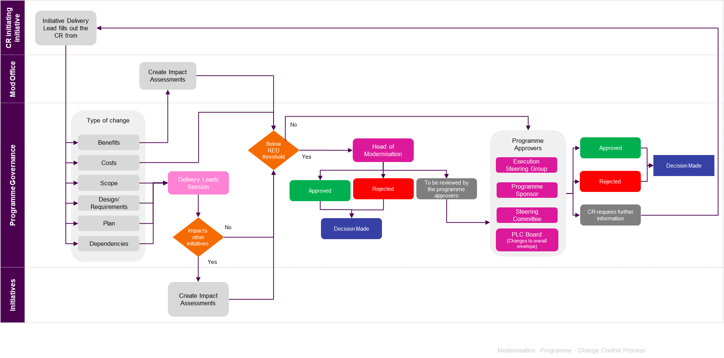
Change control
Controlling change via an agreed process that acknowledges it is needed but manages its impact for the good of delivery is key to the success of this largescale programme delivery.

Slide 27
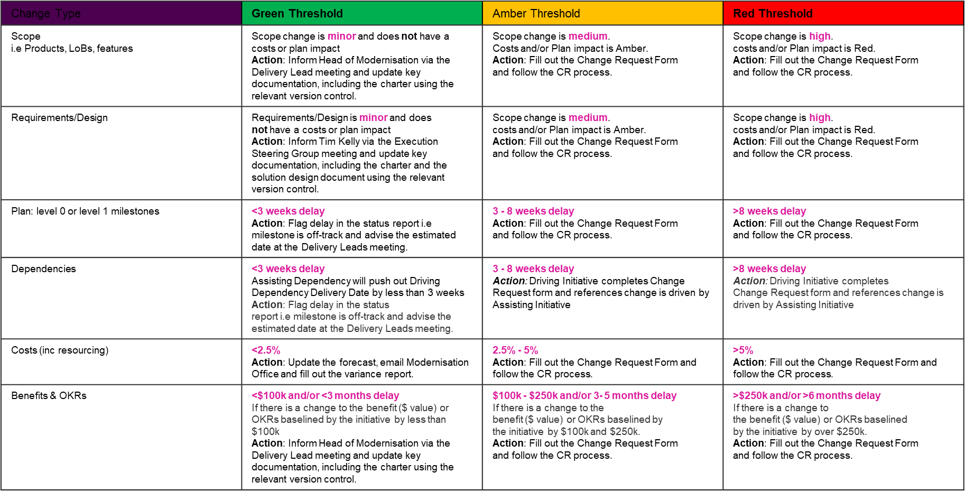
Change control (Threshold & relevant actions)

Slide 28
Raid management
We will identify, document, and review (fortnightly at least) Risks, Assumptions, Issues and Dependencies (RAID), which we will store in the overall programme RAID log on the Beazley network to ensure one version of the truth and to maintain full transparency. This will cover the following:
Risks (and their mitigation actions, owners and due dates).
Assumptions (and validation actions, owners and due dates).
Issues (and resolution actions, owners and due dates). Note: We also strictly use the daily Scrum of Scrum (SOS) calls to log all blockers (on JIRA for visibility and to drive resolution) to give the necessary visibility across the programme in a bid to drive action.
Dependencies upcoming and – if they exist – any overdue dependencies. Based on our experience, we consider strong dependency management a critical success factor, and so we will be implementing this throughout the Inception phase and beyond.

Slide 29
TOOLS FOR INCEPTION
Inception
VDIs and software installations
Outlook, MS Teams
Project planner
Microsoft Office tools- word, excel, ppt
Guidewire sandbox access
JIRA
Confluence
Microsoft Visio/Biz Design/Gliffy
Guidewire Cloud Console access
Technical and Collaboration Tools
Lewis Claxton (Beazley PMO)
Raghava Kanduru (Capgemini PMO)
Managed by

Slide 30

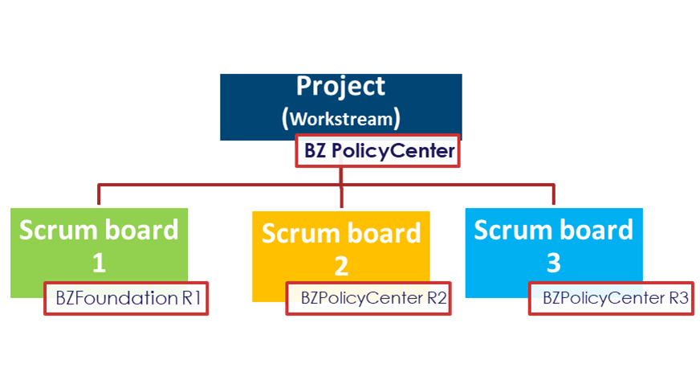
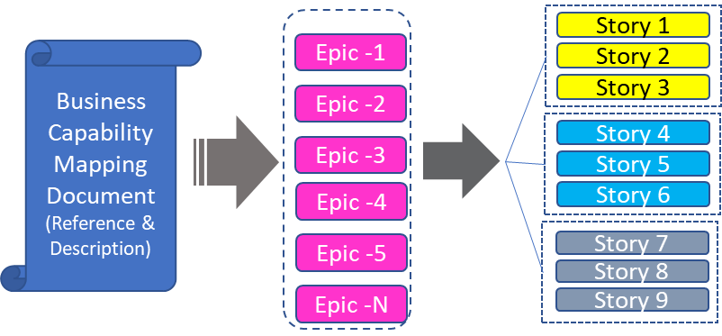
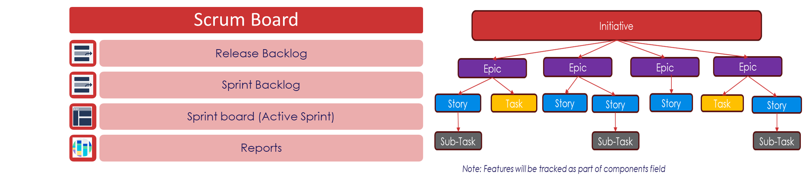
Jira Setup
Process to setup projects in Jira with one scheme configuration and upload prioritized backlog during inception phase
Step1 – Create one Schema Configuration for all GPAS projects
Step2 – Create Projects and set one scheme configuration
GPAS &Billing Projects
Screen Scheme
Workflow Scheme
Issue type Scheme
Permission Scheme
Step3 – Upload the prioritized backlog to GPAS projects

Slide 31
Build Phase updates
Sprint construct, ceremonies, reporting
Sprint Events and RACI
Approval process and SLA
User story management – illustration of possible scenarios
Key Activities and deliverables – Design & Build
A day in a life – Sprint development
Definition of Ready & Definition of Done for HLD & LLD, User Stories & Sprint
Guidewire – 3 way collaboration, Cloud assessment, Code Branching
Testing – Scope, Strategy, Deliverables and RACI, Risks/Issues
Third party management & Expectations
Metrics

Slide 32
Sprint construct
Sprint Construct
Sprint Ceremonies
Sprint Reporting

Slide 33
Teams work in 4-week Sprints with Key Events & Activities
D
Sprint Demo & Incremental Feature Demo
All user stories are demoed to Business SME for feedback and sign off. An incremental feature demo is done across sprints
Scrum of Scrums
C
Use the Scrum of Scrum platform to get help by highlight cross stream dependencies or other external factors impacting team’s progress
E
Retrospective
Team meeting to review the completed Sprint to capture learnings and agree plan of action for improvements in future sprints
Backlog refinement
For any potential missed commitments having an impact on overall Release plan, Continuous focus on Backlog to refinement is critical
Time-boxed
working
(4-week sprint)
Future Sprints
User Stories tagged to the Sprint and meeting Definition of Ready identified for planning
Sprint Planning & Kickoff
A
Daily
Plan what stories the team will develop in the sprint; the Team decides how much to pull and how they will achieve the goal
Working, tested solutions created based on the Sprint plan
B
Team Stand-up
Daily stand-up to improve coordination through a quick check-in on progress, agreeing action plans for the day and surfacing obstacles.

Slide 34


Sprint Structure for Foundation Release
Focusing on execution of current sprint while doing elaboration for next sprint
A sprint is 4 weeks in duration
Each 4 weeks duration does execution of current sprint while doing elaboration for next sprint
Elaboration For Sprint 1
Development & Testing For Sprint 1
Last week has PREP meetings for SPRINT 2 ELABORATION
Elaboration For Sprint 2
Development For Sprint 2
Last week has PREP meetings for SPRINT 3 ELABORATION
Elaboration For Sprint 3
Last week has PREP meetings for SPRINT 4 ELABORATION

Slide 35
Sprint in action on a Timeline
Sp1 Elab completes
Sp2 - 4 weeks Elaboration begins
*Only Sp1 Elaboration is 3 weeks
Sp1 - 4 weeks Build begins
Week-3 |  |  |  |  | Week-1 |  |  |  |  | Week-2 |  |  |  |  | Week-3 |  |  |  |  | Week-4
Day-1 | Day-2 | Day-3 | Day-4 | Day-5 | Day-1 | Day-2 | Day-3 | Day-4 | Day-5 | Day-1 | Day-2 | Day-3 | Day-4 | Day-5 | Day-1 | Day-2 | Day-3 | Day-4 | Day-5 | Day-1 | Day-2 | Day-3 | Day-4 | Day-5
Sprint1 preparation, validate Sprint1 DoR
Sprint1 Planning
Start Sprint1 in JIRA
Test planning, review and signoff
Test design, execution and automation
Defect triaging and retesting
Regression, demo & Reporting
Incremental Feature Demos to be planned by Beazley Product Owner across sprints, not necessarily for each sprint.
Sp3 - 4 weeks Elaboration begins
Sp4 - Elaboration start
Sp2 - 4 weeks Build starts
Sp3 - Build starts
Week-1 |  |  |  |  | Week-2 |  |  |  |  | Week-3 |  |  |  |  | Week-4 |  |  |  |  | Week-1
Day-1 | Day-2 | Day-3 | Day-4 | Day-5 | Day-1 | Day-2 | Day-3 | Day-4 | Day-5 | Day-1 | Day-2 | Day-3 | Day-4 | Day-5 | Day-1 | Day-2 | Day-3 | Day-4 | Day-5 | Day-1 | Day-2 | Day-3 | Day-4 | Day-5
Validate Sprint1 DoD
Sprint2 planning
Start Sprint 2 in Jira
Optimisation levers:
User story pushed to dev pipeline when ready
Show and tell as soon as the user story is ready
Early visibility into sprint closure through Jira dashboards
Jira to be used as the Single source of Truth on story development progress
Testing dashboards for real time progress on test- execution and defect trends
Validate Sprint2 DoD
Sprint3 Sprint planning
Start Sprint3 in Jira
Sprint2 Retrospective
Sprint1 Closure report
Sprint1 Retrospective
Sprint2
Closure report

Slide 36
Standard Development team composition
Each Release Train team – Policy, Billing, Integration would consist of cross functional skill
Release Train lead/Technical lead
Developers
Testers
Partial availability of the following groups to help query resolution OR address requirement or design changes
Business Analysts (Capgemini)
Architects (Capgeminii)
Business PO or SME (Beazley)
DevOps (Beazley)
Team Roles
Product Owner
Release Train Lead/Technical Lead
BA
  Leads Team in delivering outcomes supporting
  the strategy
  Provides business analysis; supports requirements gathering
  Leads and reinforces Agile practices
SME
Dev Team
  Brings expertise to provide guidance and feedback for capability development
  ~50% allocation
  To build & test the features
Functional Leads
DevOps
Third Party
  Functional resource who provides ad hoc expertise and guidance
  To deal with build operations & environment support
  Support required from third party app/services

Slide 37
User Story
Clear User Story standards drive quality delivery
User story structure
EPIC
User Role
User action
Business Value
Acceptance Criteria
FEATURE-1
FEATURE-2
FEATURE-N
What a user story must be
Independent
Negotiable
Valuable
Estimable
Small
Testable
US-1
US-2
US-N
US-1
US-2
US-N
USER STORY TYPEs:
A functional user story
  A story where you have a user role, action and an outcome
  Typically associated with user facing screens
  Very closely associated to the product behaviour
A technical user story
  Usually linked to a front end functional story
  Has a technical flow in the background of a functional user story
  Depends on team composition if you have separate integration team
  Applies to data and integration layer types of work
User story standards must
Follow the INVEST standard
Identify correct personas
Have a clear goal/outcome
Be explicit on pathway/flow – Given this, Then …, So that…
Meet Programme Definition of Ready

Slide 38
USER STORY Elaboration Cycle
Each User story through the elaboration phase goes through key phases of requirement capturing, aligning dependencies, conformance, drafting and a final approval
Requirement
Dependencies and conformance
PO and B SME detail requirements
Cap BA helps with OOTB Demos, aligns requirement
Business rules discussed
Align dependencies between Release Trains – Business and Cap
Dependencies include internal and external parties
Design confirmations for feasibility
GW conformance assessed, escalations reported to Beazley for approvals
User story Elaboration
Playback and approval
User story draft
Cap BA to arrange for playback sessions
Beazley PO and B SME to approve user story
All dependent teams and business aligned
User story handover to design/dev teams
Cap BA to create US draft
Single or multiple US created as applicable
Socializing with PO and business teams

Slide 39
Sprint Events and RACI
Tasks | Accountable | Accountable Team | Supporting Team | SLA/Expectations
Backlog requirements elaboration | Beazley | Beazley PO, Beazley B SME | Capgemini BA
Requirements conformance to GW product specs | Beazley | Beazley PO, Beazley B SME | Capgemini BA, Capgemini Technical team | Capgemini BA to escalate to the PO/Business SME if requirement are deviating from product conformance (ex <90%). This happens immediately during the Sprint elaboration sessions much before development begins
Requirements clarification for dependent systems | Beazley | Beazley PO, Beazley B SME | Capgemini BA, Capgemini Technical team | All dependent RT expectations are aligned by the Beazley PO
Business validation definitions | Beazley | Beazley PO, Beazley B SME | Capgemini BA
Acceptance criteria definition | Beazley | Beazley PO, Beazley B SME | Capgemini BA
Business Process Maps traceability to GPAS & Billing Backlog Items | Beazley | Beazley PO, Beazley SME | Capgemini BA | L4 Process Maps created by Beazley to be mapped to GPAS & Billing backlog items at Epic/Feature level by Beazley
User story creation | Capgemini | Capgemini BA | Beazley PO, Beazley B SME
User story creation in JIRA | Capgemini | Capgemini BA | Capgemini RTL, Technical SME, Capgemini BA
User story sign-off | Beazley | Beazley PO, Beazley B SME | Capgemini BA | All user stories to be signed off by PO within 2 days after issuance
Sprint planning | Capgemini | Capgemini Release Train lead | Beazley PO, Beazley B SME(s) | All Beazley managed Release Train leads, Beazley PO, Beazley Business SME
Playback sessions | Capgemini | Capgemini BA | Beazley PO, Beazley B SME | All Beazley managed Release Train leads, Beazley PO, Beazley Business SME
Backlog adjustments | Capgemini and Beazley | Capgemini PO, RTL Beazley PO | Capgemini Technical team

Slide 40
Sprint Events and RACI
Tasks | Accountable | Accountable Team | Supporting Team | SLA/Expectations
Validate Sprint Definition of Ready | Capgemini | Capgemini RTL, Capgemini BA | Beazley PO, Beazley B SME
Validate Sprint Definition of Done and Sprint acceptance | Beazley | Beazley PO, Beazley Programme Manager | Capgemini RTL, Capgemini Technical SME | Beazley Programme team to sign off Sprint Closure report issued by Capgemini within 24 hours after submission A summary of the Sprint DoD status supported by JIRA reports (specifics to be agreed) Time to issue report : Up to One week after Sprint completion
Validate User story definition of ready | Capgemini | Capgemini RTL, Capgemini BA | Beazley PO, Beazley B SME
Validate User story definition of done | Capgemini | Capgemini RTL, Capgemini BA | Beazley PO, Beazley B SME
User story show and tell (Demo) | Capgemini | Capgemini RTL, Capgemini BA | Beazley PO, Beazley B SME | Beazley to sign off the stories in JIRA within 24 hours
Incremental Feature Demo | Beazley | Business Product Owners, Business SME | Capgemini BA | Beazley to decide on the timing for an incremental feature demo
JIRA reports for all DoD, DoR | Capgemini | Capgemini JIRA admin
Sprint start and closure in JIRA | Capgemini | Capgemini RTL, Capgemini RTL, Capgemini JIRA admin | Beazley PO, Beazley B SME, Beazley Programme team | Beazley Programme team to sign off the JIRA report for Sprint start and closure
Technical tasks creation in JIRA | Capgemini | Capgemini Technical leads, RTL
Updates to JIRA user story progression (dev, test etc) | Capgemini | Capgemini RTL, Capgemini Technical Leads
Sprint retrospective | Capgemini | Capgemini RTL | Beazley PO, Beazley B SME

Slide 41
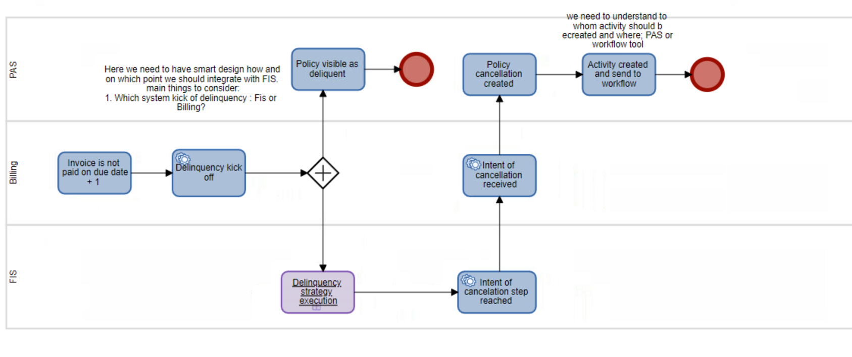
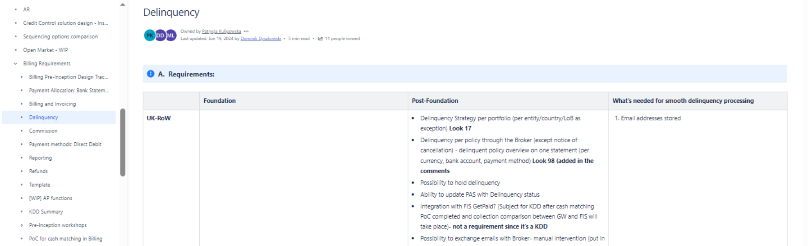
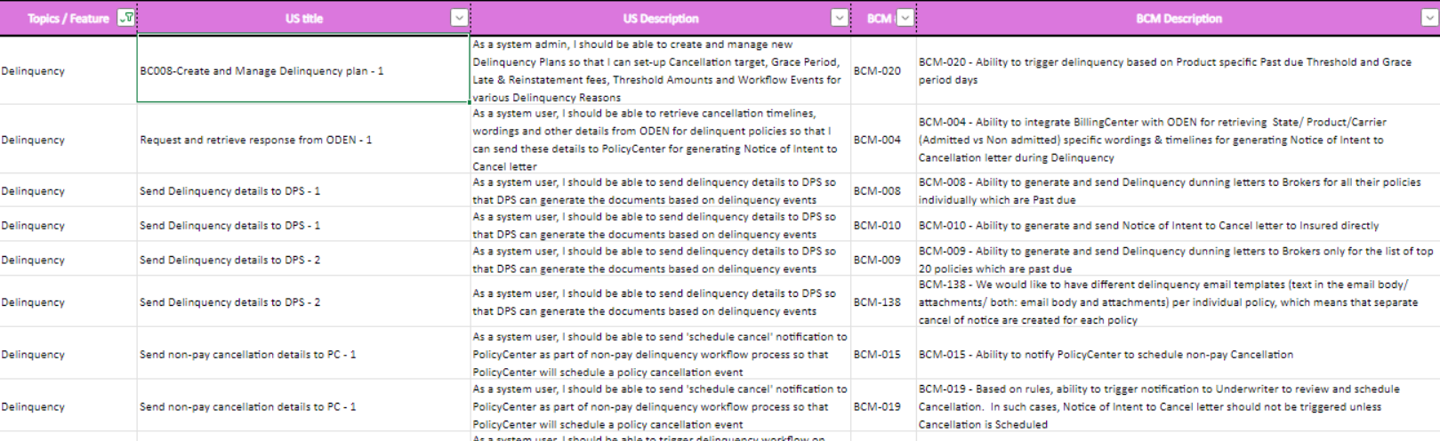
Traceability from Business Outcomes through to a Test case
Business Process Maps (L4)
Epic and Feature elaborated in Product Backlog
Test scenarios and Test Cases for each User story
User stories for each Epic and Feature
Beazley Business Outcomes requirements in GPAS & Billing
Primary Responsibility lies with Business Design Team to generate the L4 Process Maps that link back to a Business Outcome
Beazley to map the L4 Process maps to an Epic or Feature (proposed using unique ids for each process map)
All Epics & Features are uploaded to JIRA
GPAS and Billing Product backlog created as Inception phase outcome – lists Epics, Features and User stories
All Epics, Features and User stories are uploaded to JIRA
In the build phase, all test scenarios and test cases created are linked back to user stories in JIRA
Illustrative scenario – BillingCenter Delinquency – Business Process Maps to Guidewire Backlog during Inception
L4 Process Maps for Delinquency with different system flows between PAS and Billing
Business Requirements Backlog created by Business SME/PO that becomes input to Inception workshops
BillingCenter Guidewire Backlog for Deliquency derived with Epics/Features and User stories

Slide 42
Scrum of Scrums (SoS)
  What is Scrum of Scrums (SoS)?
  A stand-up which is one level above the daily team Scrum stand-ups. SoS is essential in Large programs for leadership to get first-hand view of current impediments or potential future ones that impact the progress teams can make on day-to-day basis. Program leadership is expected to unblock issues for the team to proceed. Example of SoS entries can be - risk of missing a dependency, or a missed dependency, requested test data not being available as per SLA, Demo sign-off pending etc
  What is the frequency of SoS?
  Ideal is daily at least for initial sprints and later can be reviewed to reduce it to 2 or 3 times a week.
  Who are invited to the Scrum of Scrums?
  Release Train Engineers from all Release Train Teams (Cap, Beazley and Hexaware) – ex: Policy, Billing, Migration, Infra, Testing etc
  Program Directors from Capgemini & Beazley
  Program and Delivery Managers from Capgemini & Beazley
  Functional Heads and Business Product Owner(s)
  What will be discussed in Scrum of Scrums?
    A JIRA board will be used to log all items eligible for Scrum of Scrum meeting
    Check progress on any unresolved SoS entries
    Review new entries
    Review active risks/issues that have potential impacts to Sprint velocity or the overall Release Goal
  Where to raise/create SOS tickets?
  Release Train Leads must use JIRA SoS board - “GPAS & Billing Scrum of Scrum” to log entries with complete details and assigned them to respective dependent teams/representative
  Who runs the Scrum of Scrums:
  Beazley is expected to set-up, run and govern the SoS meetings

Slide 43


Retrospective
Release Train Sprint & Program Sprint Retrospective session are conducted at end of sprint to inspect, adapt & identify next sprint improvements
Release Train Sprint Retrospective
Program Sprint Retrospective
Who runs
Release Train Lead
Who runs
Beazley Program Manager
Participants
Product Owner/Business SME
Development Teams
Testing Teams
Participants
Product Owners
All Release Train Engineers (RTE)
Program & Delivery Managers (Cap & BZ)
Program Directors (Cap & BZ)
Agenda -
Sprint team to review what went well & what can improve
Identify & agree areas of improvement needed going forward
Agree on applicable action items & mechanism to track
Agenda -
All RTE share the release train sprint retrospective updates
Identify & agree areas of improvement needed going forward
Agree on applicable action items & mechanism to track
Note: All retrospective decks are stored in confluence

Slide 44
User Story management

Slide 45
User story management
Key Scenarios:
Elaboration is complete in one sprint, development takes multiple sprints
User story development planned for a sprint does not complete within the sprint timeline
One Epic requirement developed across multiple Release Trains in the same sprint
Elaboration is across multiple sprints and development is across multiple sprints
User story Elaboration does not meet definition of ready for sprint development

Slide 46
Scenario 1 – Imburse - Payment Integration
Elaboration in one sprint, implementation in multiple sprints
Elaboration phase completes requirements capture, acceptance criteria for complete Imburse - Payment Integration feature
The Cap technical SME confirms the entire Imburse - Payment development cannot be complete in one sprint
Reason – dependency on Imburse integration design, Specification, environment availability and high complexity
Current sprint – continue with mock response and complete partial demo
User stories uploaded to JIRA with an appropriate sprint assigned
User story is taken up for development in the assigned sprint
All related user stories will be linked to the same Imburse - Payment Integration EPIC in JIRA
BA to document multiple user stories aligned to multiple sprints based on Technical SME input provided, PO to approve

Slide 47
Scenario 2 – User story spill over
User story planned for a sprint does not complete within the sprint timeline
User story planned for a sprint development and test
IMPACT: Story cannot be done in the current release or has a cascading impact on remaining work in the release?
Impacts release timeline
User story unable to meet its sprint definition of done for different reasons:
External or Int dependencies not met
Test execution incomplete
Last moment data contract changes
Outstanding high severity defects
User story approval delayed by PO/B SME
No Impact to overall release timeline
RTL, PO discuss the options for next steps:
Clone the user story and assign the new story for next sprint (specific to the pending work)
Adjust current user story effort for the work already done
Begin the change request procedure for impact assessment and prioritisation
The progress made on the US and pending tasks are analysed:
Amount of development pending?
Amount of testing pending?
High severity defect fixes pending?
Updates to JIRA : New cloned User Story* moved to next sprint, current user story marked to Done state
Updates to JIRA : If the pending work is minor, user story is marked Done in the same sprint after completion
*Cloned story will be automatically linked to the existing story. The cloned story will have pending efforts from existing story as its story points, (Ex- if existing story is 13 SPs after the split, new cloned SPs will be 5 SPs & existing story will be changed to 8 SPs)

Slide 48
Scenario 3 – User story in multiple streams – Rating Service
One Epic requirement developed across multiple Release Trains in the same sprint
BA and Technical team agree on technical dependencies for Rating Service to exist on External Rater and UWWB
Updates to JIRA: 3 separate user stories by Release Train created in JIRA with a dependency chain
BA to document separate user stories for each of the Release Trains in the current sprint
Policy development
UWWB Rating service development
External Rating dependency
User stories make it to development depending on the sprint tagged to them
All related user stories will be linked to the same Policy search and Retrieve EPIC in JIRA
PO to approve the user stories

Slide 49
Scenario 4 – Complex Integrations
Elaboration done in multiple sprints and implementation done in multiple sprints
BA identifies, complex integrations like MS Dynamics CRM - Customer and Broker management,Snowflake - Data Warehouse,Imburse - Payment Integration need elaboration across more than one sprint
Updates to JIRA: Multiple stories created in JIRA with an appropriate sprint assigned for development
BA and PO agree on an elaboration plan across sprints with targeted acceptance criteria
Design team confirms the split helps incremental design
Each user story undergoes Elaboration and development subsequently depending on the sprint they are assigned to
BA to create multiple user stories with the current visibility and tag them to sprints. PO to approve
All related user stories will be linked to the same Integration EPIC in JIRA

Slide 50
Scenario 5 – User story does not meet DoR, DoD
User story fail to meet their definition of done or ready at elaboration or execution phases
A user story elaboration does not meet definition of ready for Sprint start
A user story build does not meet definition of done for the sprint
For all significant effort spilling over due a non-Capgemini dependent reason and that cannot be accommodated in the release, explore the Change Request process for IA and next steps
Due to multiple reasons
Business SME or PO approval pending
Technical outcomes not achieved
Dependencies not elaborated
Due to multiple reasons
Technical dep not resolved
More complex work involved
Queries pending resolution
BA and PO approve -User story moved back to backlog to be picked up for future sprint
BA and PO approve -User story moved back to backlog to be picked up for future sprint OR user story is split to next sprint specific to work pending

Slide 51
Activities list

Slide 52
Elaboration Phase Activities (elaboration + design)
Key activities during Elaboration include:
  Clear evaluation & review of overall product & release back-log to assess where programme stands compared to the Go-Live
  Where prep work is required, BAs will work with SMEs, POs and dependent teams to confirm what is needed in the elaboration workshops, based on the User Stories
  PO and BA will define or identify user stories from the Project (release) backlog for sprint planning
  At the start of each workshop, BAs will provide an overview of how to break down a User Story and what a good user story looks like
  User Stories will be elaborated as per Definition of Ready with agreed acceptance criteria
  Architect will review the User Stories to determine if there are any architectural considerations to be taken into the build
  Artefacts required for each User Story will be agreed between the Release train team, PO and Architect
  Sprint backlog and associated documentation is reviewed by PO and agreed to be ready to take into the Design Phase workshop
  Where Out Of The Box functionality is included in the sprint, the environment should be available for demo
Activities | Overview | Duration | Roles | Inputs | Outputs
Sprint Planning | Sprint planning to review all the items in the backlog, identify all dependencies and any pre-requisites for the Sprint. The opportunity to share the vision and agree the Sprint Goal | 4 hours* | RT, PO, BA, SME’s, Architect Dependent team Leads | Backlog | Sprint Backlog to be taken into the Design phase Workshops
Stand-ups | Standup to track Sprint N readiness and plan Sprint N+1 | Daily 30 minutes | RT, PO, BA’s, SME, Architect, | Items on the board | Dependencies and blockers identified with accountable owner and target closure
Workshop | Detailed elaboration of requirement (Design Phase) and user stories | Daily 6 Hours max* | RT, PO, BA, SME, Architect | Backlog | Design Phase deck and detailed user story
Review | Review user story for formal acceptance by PO | 3 Hours* | RT, PO, BA, SME, Architect | Backlog | Finalized Sprint Backlog
Retrospective | Part of the overall Sprint retrospective to provide feedback and suggest improvement | 1 Hour | RT, PO, BA, SME, Architect | Feedback | Recommendations
PO – Product Owner
BA – Business Analyst (Cap+Beazley)
SME – Subject Matter Expert
*Sprint planning, Workshop and Review frequency and duration will be at the discretion of PO, BA and Stream Lead
RT – Release train (Cap+Beazley)
*Beazley here means Beazley other programme Release Trains that are required in the activity

Slide 53
Build Activities
The objective of Build is to deliver user stories approved for the sprint
Key activities during Build (Sprint Execution) include:
Sprint kick off in Jira provided Sprint definition of ready is met.
Dev team to manage sprint backlog during sprint execution and will prioritize user stories for build
User stories in JIRA updated for remaining effort on frequent basis
Update story status, comment and due date in Jira to reflect latest status for reporting build progress, test execution, blockers, defect and dependency
Sprint progress will be tracked daily via Jira dashboard(s)
Release Train Leads to monitor sprint execution progress on daily basis
User stories that meet Definition of Done will be demoed to the PO and , Business SME for sign off
Stories that do not meet sprint goal OR Definition of Done will return to the product backlog for further refinement and prioritisation
Code merge activities if applicable in parallel release development
The desired outcomes of the Sprint and reporting includes:
  Unit Test Results
  Code Review Results
  QA sign off
  Daily sprint progress report (Jira dashboard snapshot)
  Sprint completion report
  Sprint retrospective
Ceremonies | Overview | Duration | Roles | Inputs | Outputs
Stand-up | Stand-up as part of the overall Sprint per Release train | Daily 30 mins | Release train | Items on the board | Dependencies and blockers identified and tracked for target closure
Scrum of Scrum | Standup to track sprint dependencies and blockers across Release Trains | Daily 30 mins | RT Leads | Items on the board | Dependencies and blockers identified and tracked for target closure
Sprint Planning | Last day of Prev Sprint and First Day of current Sprint - Review readiness of stories identified for Sprint | 2 Hours | Scrum Team | User Stories | User stories ready for development
Demo | As soon as user story build is complete - Demo of completed User Story to PO/Business SME | 1 Hour | PO, BA, Scrum Team | Product Increment | User story signed off by PO
Retrospective | After Sprint completion - Retrospective to provide feedback and suggest process improvements | 1 Hour | PO, BA, Scrum Team | Feedback | Recommendations
*Review and Demo frequency and duration will be at the discretion of PO, BA and Stream Lead
PO – Product Owner
RT – Release Train
SME – Subject Matter Expert

Slide 54
‘A day in a life’ during Sprint Development
Accelerators / Tools
All stories in-scope are signed-off, all templates updated
JIRA for backlog management, development progress tracking
Dev environments available
SOS board usage
Logs for risks, issues, dependencies & actions
Use war rooms to collaborate
All in-scope and signed-off user stories to be handed over to development team
All blockers to development or test execution are raised as SOS (Scrum of Scrum) blockers by Release Train leads, use war rooms to resolve
Cap BA, Architect & Development teams to conduct Sprint Planning to validate DoR for sprint & each story. Sprint goal is agreed.
User stories completing test execution are demoed to Business SME and signed-off
Best Practices
Sprint planning sessions also cover – dependencies review, identifying key risks and issues that might impact sprint goal
JIRA as a single source of truth for the entire team to track user story progress on daily basis
Raise any blocker immediately on same day – get it to the SOS
Always review DoR for user stories before start & DoD after completion
Prg Mgmt to review SOS daily and unblock issues urgently
Differentiate and report Change requests vs Defects, especially during story demo
Schedule all demo upfront to block time, Business SME not to delay sign-off
Keep an eye on the release goal in parallel to highlight risks/issues to the overall timeline
Cap BA or Business SME resolve queries raised by Developers or Test analysts against user stories assigned
All unexpected impediments delaying user story completion are taken up for review & backlog refined accordingly
Daily stand-ups conducted separately for each Release Train (Policy, Billing, Integration etc). All risks/issues/dependencies are reviewed & logged
Continuous review of Sprint progress by Program Management for any impacts on end Release goal
Challenges
Actors
Product Owner
SMEs
Solution Architect
Team members
Functional Lead / BAs
Test teams
User story sign-off and handover on time before Sprint start
Business SME time for demo & sign-off, last moment changes during demo
Missed dependencies always affect critical path
Delayed decision making across the teams affecting sprint goal – Dev, Design or Business

Slide 55
Approach in dealing with Technical Spike Items
Integration points from the Integration Inventory (manifest) qualifying as a Technical Spike item (to validate flow and connectivity) will be taken up with Capgemini and Beazley architects
Prior to being taken up, all Technical Spike items must be assessed for impact on the Release effort & timeline
All Technical Spike items must be small, definite and taken up to provide the necessary insights specific to the problem area and not be an effort to build a full solution
Technical Spike items must be taken up for completion during inception or sprint elaboration phase of a sprint and not during development weeks in a sprint
All Technical Spike item that may arise during development phase must be added to the Release backlog to be prioritized as necessary
Any Technical Spike item that have dependency outside Guidewire PolicyCenter, BillingCenter and Guidewire Integration Gateway will need to be supported by Beazley

Slide 56
Definition of Ready (DoR) and Definition of Done (DoD)

Slide 57
High-level Design – DoR and DoD
HLD Definition of Ready
HLD Definition of Done
Business Requirements: The business requirements are well-documented, clear, and approved by stakeholders.
Scope Defined: The scope of the project is clearly defined, including what is in and out of scope.
Architectural Vision: An initial architectural vision is available.
Stakeholder Alignment: All key stakeholders are identified and aligned with the high-level objectives.
Resource Availability: Necessary resources (e.g., architects, senior developers) are available and assigned.
Technical Constraints: Known technical constraints and dependencies are documented.
Service Provider: Alignment with the service provider with regards to capability, design principles and well documented design
Design Documentation: Complete high-level design documentation, including system architecture, data flow diagrams, exception flow and key components.
Review and Approval: Design has been reviewed and approved by stakeholders, including architects and business SMEs.
Alignment with Requirements: Design is aligned with business requirements and scope.
Feasibility: Technical feasibility has been confirmed.
Compliance: Design adheres to relevant standards, principles, and regulatory requirements.
Integration Points: Key integration points with other systems are identified and documented.
Dependencies: Major dependencies are identified and planned for.
Solution designs must be in Beazley standard template as a minimum.

Slide 58
Low-level Design – DoR and DoD
LLD Definition of Ready
LLD Definition of Done
High-Level Design Completed: High-level design is completed, reviewed, and signed off by stakeholders i.e. technical and business architects.
Detailed Requirements: Detailed functional and non-functional requirements are documented and approved.
Technical Specifications: Low level technical specifications from Service provider and guidelines are available.
Resource Availability: Necessary resources (e.g., developers, technical leads) are available and assigned.
Development Tools: Development tools and environments are set up and accessible.
Interface Definitions: Interface definitions are available for components that will interact with others.
Acceptance Criteria: Acceptance criteria for low-level design are defined.
Detailed Design Documentation: Complete low-level design documentation, including detailed class diagrams, sequence diagrams, database schema, and API specifications. Including Exception flow.
Standards: Design adheres to GW and Beazley standards and guidelines.
Review and Approval: Design has been reviewed and approved by technical leads and architects.
Traceability: Design elements are traceable back to high-level design and requirements.
Performance Considerations: Performance and scalability considerations are addressed.
Security: Security requirements and considerations are integrated into the design.
Testability: Design ensures that the system is testable and includes test cases.
Documentation: All relevant documentation is updated and accessible. Solution designs must be in Beazley standard template as a minimum.
*LLDs will be developed in parallel with sprints

Slide 59
User story – DoR and DoD
User Story Definition of Ready
User Story Definition of Done
Requirement package is signed-off by Beazley SME which consists of a documented user story and acceptance criteria(s)
User Stories are elaborated to have detailed functional, non-functional, integration requirements, business rules, FLS, process flows, mockup screens (only if applicable) and well-defined acceptance criteria
Requirements hand-over is complete by Cap BA to development team
All known dependencies associated with delivering a story have been resolved or any pending ones have an eta for resolution not affecting the user story development outcome
Any dependent user story across PC config, integration, policy or billing is already available or has a plan in place not impacting the current story acceptance criteria
Product dependencies (finalized Xmind map and APD ) for story development are available
User story development does not add customization above permissible guideline of 10%
Any pre-dev tasks created during elaboration are marked complete in JIRA
Third party connectivity dependency is resolved and available
Agreement in place to use stub services or an alternate in absence of a working live integration
User story is successfully demonstrated on top of the code built during the Sprint, that meets the acceptance criteria and is signed off by the PO/Business SME
Unit test result and code review result are uploaded in Jira/Confluence
Stub routines used to complete unit testing where a third-party service live integration is not available
Code complies with GW cloud coding and security standards; all valid observations have a plan of action agreed
Code is ready for deployment to a Test environment
All sub-tasks of the user story are in DONE status
Unit test cases to be achieved through Gunits
Data tracker should be updated for any Data model changes
Test execution is complete with no ‘ To Do’ test cases pending in Jira OR there is an agreement and ETA for the pending ones
No outstanding High Priority or Severity defects resolution open on the defects OR for any open ones, there is a conditional sign off with a ETA for fix. The defect priorities and severities will be assigned as per beazley QA defect management process. Ref testing - slide 65. The defects will be tracked in Jira through triage process.
Test data used to test the scenarios are relevant and sanitized to ensure no production data is used.
Identified automatable test cases are automation completed and integrated to the pipeline

Slide 60
Sprint – DoR and DoD
Sprint Definition of Ready
Sprint Definition of Done
Sprint backlog hand off (technical and functional clarifications with PO/Business SME) is complete and user stories are in compliance with Definition of Ready
Sprint backlog is based on the available sprint capacity (Build & QA hours available)
Product Data Model requirements are finalized any Data requirements are resolved or have a plan in place without impacting Sprint delivery
HLA is signed-off by the architecture team wherever applicable ( applicability of this is determined during elaboration of requirements)
Other Design items to be in place
  External API or vendor specification document
  IP whitelisting completed for any third-party connectivity
  Service request and response mapping documents
All dependencies have been resolved. Dependency items are agreed for all third-parties (internal and external)
Environment configuration completed, and access setup done for Release train members
All user stories and sub tasks within a user story are in Done status
Completed user stories follow the User Story Definition of Done or any exception is agreed with Beazley
Stories not in ‘Done’ status have been moved out of the sprint in agreement with Beazley – Stories not in Done status are discussed with respective Product Owner based giving a visibility of a completion plan or a risk if exists. Story is either moved to subsequent sprint or parked in backlog for further action. (Please refer to User story management section for specific scenario covering this)
Test execution is complete in Jira with no test cases in ‘To Do’ status or if any exception is agreed with Beazley
High priority or severity defects have been either closed or there is a mutually agreed fix plan with Beazley for the open defects
Code has been checked-in accordance with the DevOps pipeline
Sprint completion reports has been shared with Beazley stakeholders - Product Owner, Programme management team
Automation testing (if applicable) has a coverage to the requirement level as defined in the test strategy
Sprint completion reports have been shared with Beazley stakeholders - Product Owner, Programme management team
PO – Product Owner
HLA – High Level Architecture

Slide 61
WORKING WITH Guidewire alignment, governance and assessments

Slide 62
THE 3-way collaboration for success
For the success of GPAS & Billing Program, It is critical for Capgemini-Beazley-Guidewire to work in close collaboration across phases of the Program execution.
BEAZLEY
GUIDEWIRE
CAPGEMINI
Finalize & maintain Product contract with Guidewire
Conform requirements to OOTB
Timely approvals pending architecture or design considerations
Review code assessment reports
Adhering to the Release management prescribed by Guidewire
3 Way Cadence on Need basis
Weekly Cadence
Deploy certified technical team
Build GPAS & Billing Code on SaaS platform
Conform to Guidewire Cloud Coding standards
Resolve Cloud assessment observations
Collaborate for all major design decisions
Provide SaaS platform to deploy GPAS & Billing solution
Provide Dev and Prod environments
Perform Code assessments & Design validations
Updates on new product version releases
Provide SME support as per the agreements with Beazley & Capgemini
Weekly Cadence
KEY SUCCESS FACTORS
Align requirements to Product
Design and Build to standards
Collaborate on decisions

Slide 63
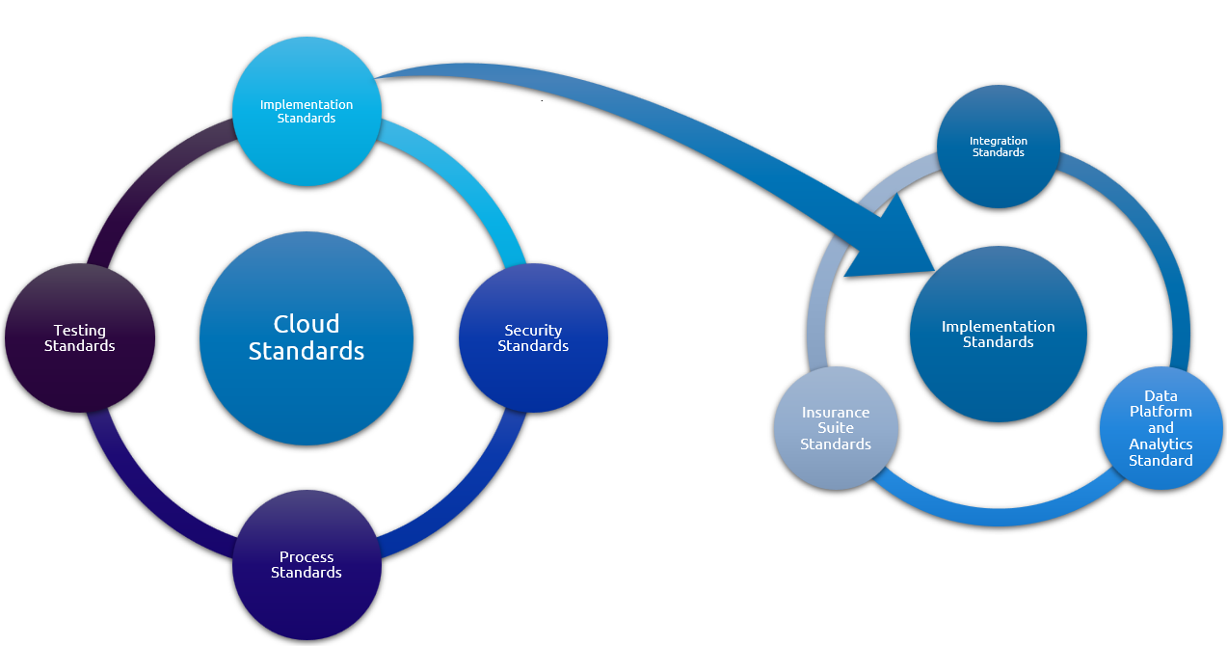



Guidewire Cloud Assurance Assessment (CAA)
Cloud Assurance Program Goals are:
Assess and report adherence to Cloud Standards
Enforce remediation of Cloud Standards violations by the implementation team
Competency Assurance - Periodic reviews conducted to ensure all Developers and Analysts are appropriately trained, certified and each workstream has the required Lead to Associate ratio (1:3). Managed by Guidewire Education team
Overview:
Purpose: Validate if developed code conforms to Guidewire Cloud
standards
Frequency: Monthly, at the end of each Sprint/Stabilization/Pre-Go-live
Assessment Methods:
Automated Cloud Assurance is executed in TeamCity to run inspection on all Cloud Standards that have assessment type “Partial/Fully Automated”.
Additional manual code review of Cloud Standards that have assessment type “manual” are carried out by the Guidewire Cloud Assurance team
Outcome: Is a Cloud Assurance Report:
GW provides report on custom code that violates Cloud Standards
Provides suggested remediations in the Guidance section of the Cloud Assurance Report
Capgemini and Beazley teams are provided access to the report
Review, Resolution & Reporting Process:
  Issue Identification:
    Guidewire team identifies and documents issues in the Cloud Assurance Report
  Assigning observations to developers
    All Cloud Assurance Report items are moved to JIRA board, assigned priority, and assigned to developers for fix
    Any conversations on reported issues with Guidewire are completed by team ad-hoc and almost immediately
  Reporting:
    The Guidewire observations fix status is reported via JIRA in the Sprint closure review provided to Beazley

Slide 64
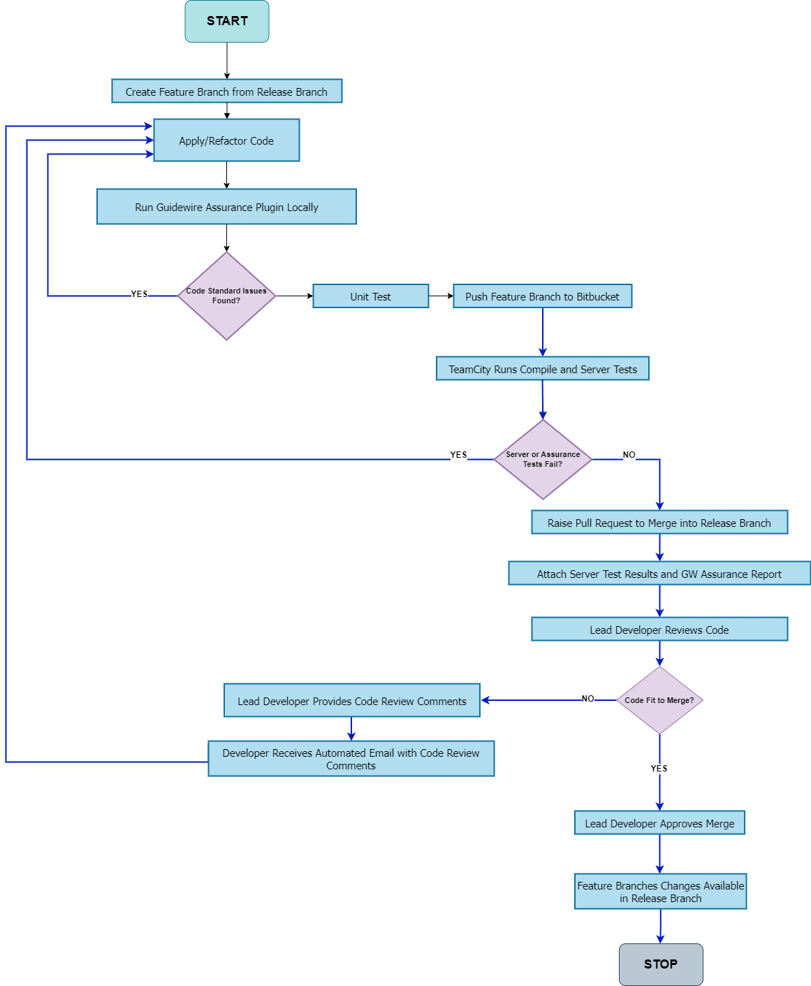
Developer Workflow
Feature Branch Creation and Code Changes
  Developer creates a Feature Branch from the release branch and applies changes to the code.
Developer Code Inspection
  Developer runs the Guidewire Assurance plugin to find deviations from cloud standards.
  If any code standard issues are reported by the plugin:
    Developer fixes the issues and re-runs the Guidewire Assurance plugin.
Pushing to Bitbucket and CI/CD Pipeline
  Developer pushes the Feature Branch to the Bitbucket repository and waits for the TeamCity CI/CD pipeline to run.
Handling Test Failures
  If server or assurance tests fail in the TeamCity CI/CD pipeline:
    Developer rectifies the code in Guidewire studio , pushes the changes to the Feature Branch and continues this cycle until the server test and assurance test pass in TeamCity.
Pull Request and Code Review
  Developer raises a Pull Request (PR) to merge the Feature Branch into the release branch.
  Lead developer provides code review comments within the PR and creates a task for the developer to refactor the code.

Slide 65
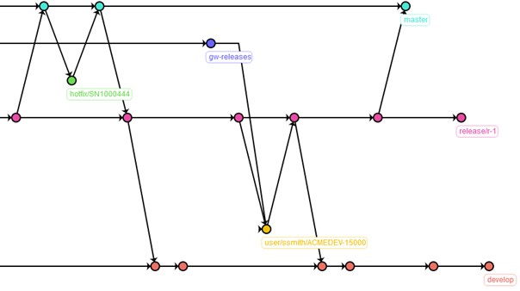
Git Branching and Merging Strategy
master branch: Updated post release or during emergency fixes
Guidewire Standard: Follows "Guidewire GW-MTH-1084 Branching Strategy for Guidewire Implementation Projects."
  Ensures robust, consistent process for managing parallel code changes within and across releases.
  Intended for technical leads and implementation consultants.
  Uses Git repositories for version control of source code and software artifacts
  Managed using Guidewire-provisioned Bitbucket Server instance.
  Implements the branching strategy described in the standard.
Branching Strategy Overview:
  Production Branch (master):
    Single production branch named master. Contains out-of-the-box product and configurations at project start.
    Updated only during release activities or emergency fixes by senior developers.
gw-releases branch: Owned by GW
release branch: Created when the project enters stabilization phase
hotfix branch: Used for high-severity production incidents
user story branch: Changes pertaining to a user story developed in the user story branch
  Product Release Branch (gw-releases):
    Created off master at project start for new product versions and owned by Guidewire Customer and Cloud Operations.
develop branch: The mainline branch, contains all code across all releases
  Defect Branches:
    Created off develop or release branch for defects.
  Project Release Branches (release/r-*):
    Used to stabilize code before moving to production and Named as release/r-{release_number}.
  Hotfix Branches (hotfix/*):
    For high-severity production incidents and created off master and named hotfix/{id} and merged back to master and other branches by authorized developers
  Mainline Branch (develop):
    Single mainline branch named develop, created off master and contains all code across all releases.
    Accessible to all team developers for merging.
  User-Story Branches:
    Created off develop or release branch for user stories.
  Note:
  Code management strategy will be revisited once the single instance vs multiple instance code base approach is finalized (US region and UK region specific)
  For the initial foundation release, there will be a single branch (develop)

Slide 66
Guidewire updates Process
Capgemini’s GUIDEWIRE UPDATES SCOPE
Capgemini will Update Beazley’s Foundation Release to have the latest GW v10 release of PC and BC components
To best protect the release delivery timeline, Version Update will be taken-up during Sprint development phase and not in Stabilisation phase (E2E+UAT)
To keep the Update efforts within the plan, Beazley implementation must stay within 10% customization limit
Updated code base will undergo regression testing, deployments into higher environments & developer synch-up activities
GUIDEWIRE LAYER AND CUSTOMER LAYER
The Guidewire layer and customer layer are defined to designate clear ownership of files that are contained within the InsuranceSuite artifact
For every Version Update cycle, Guidewire will perform the Guidewire Layer update, followed by Capgemini doing the customer layer update and regression testing
Indicative timeline for each Update activity
Updates by Guidewire – 1 to 2 weeks
Updates by Capgemini for Beazley code base – 1 to 2 weeks
Regression testing across dev & test environments within build phase – 1 to 2 weeks
Final sign-off by development team & developer workspace synch-up – 1 week

Slide 67
Testing

Slide 68
scope
Draft – To be updated once Test Strategy is finalized
In Scope
Out of Scope
Functional testing of Guidewire PolicyCenter & BillingCenter which is configured as per the requirements finalized and documented in the Product Backlog. The below scope might change based on the outcome of the architecture discussion which is in progress
  Policy life cycle transactions (Example - New Submission, Policy change, Cancellation, Renewal, Rewrite and Reinstatement etc.’)
  Document triggers only – both out of the box and any customizations requested in requirements.
  Business Rules- Underlying policy business rules (Underwriting, extension & renewal)
  Roles- Role based testing (Underwriting org structure feed)
  Billing lifecycle (Example - Co-insurance management, Delinquency management, Invoicing & commission management)
  Batches in Policy Center and Billing Center.
Integrations - Integrations with PAS / Billing through Integration Gateway and/ or direct through Integrations from guidewire. For example: (Authentication, Billing & Delinquency).
Test automation – Sprint level test automation aligning to overall Automation Strategy
Product Rationalization –Product Model will be converted as ADL (Admin Data load) and this will be validated against the relevant user stories.
Migration testing - Policy Migration of D&O product lines from Source (On-prem) to Guidewire cloud
End to End Testing with components outside GPAS and Billing during Sprints
Systems outside Guidewire - Policy Center & BillingCenter
3rd Party management – For Example – Scheduling/Planning, agreeing contracts, managing defects etc.
Documents Testing (DocVault)
NFT, OAT and UAT. Refer (E2E Test strategy)
Beazley legacy system & its corresponding integration testing
Downstream Systems within the Modernization Program
Any other components that are not part of In Scope

Slide 69
Types of Testing
Draft – To be updated once Test Strategy is finalized
Build & Test Phase
Sprint N
Week-1 |  |  |  |  | Week-2 |  |  |  |  | Week-3 |  |  |  |  | Week-4
Day-1 | Day-2 | Day-3 | Day-4 | Day-5 | Day-1 | Day-2 | Day-3 | Day-4 | Day-5 | Day-1 | Day-2 | Day-3 | Day-4 | Day-5 | Day-1 | Day-2 | Day-3 | Day-4 | Day-5
Sprint1 Planning
Start Sprint1 in JIRA
Test planning, review and signoff
Test design, execution and automation- A, B & C
Defect triaging and retesting- A,B & C
Regression, demo, retrospective& Reporting- D
A- Functional testing-
To test the system has been configured according to the provided acceptance criteria within the User story and this includes validating the Business rules, UI screens and field level validations.
Requirement Traceability Matrix will be used to reflect the test scenarios coverage for requirements. This will be carried out for every user story as part of sprint for the following areas of capability or functionality such as Account creation & Policy Information
All the Test scenarios/test cases will be peer reviewed by test leads.
The test data required to perform the tests with variations will be compiled by the testing team. Data which has dependency from other systems will be coordinated and made ready before test execution.
B-Integration testing-
To test each component is integrated with each other. Our Integration testing validates the payload of PolicyCenter and BillingCenter integrations through MDA/CDA and dependent systems should validate their own validations. This includes Internal and External Integrations. For Example, Internal Integrations (Authentication, Document Management) & External Integrations – Appian (Workflow Management), Oden, Oanda (Exchange Rate Service).
These Integrations are tested by a method called API testing using (SOAP UI/POSTMAN) to verify the response with provided request and End point URL.
This will validate various actions including Authentications, Payloads, response headers and basic schema validations & type lists.
In-Sprint Integration testing - Integrations finalized in the Integration Manifest, will need to arrive at the sprint schedule in line with the sprint plan. Any deviations to this will need to be impact assessed. If these deviations can be accommodated without impacting the overall in-sprint testing schedule, Capgemini will seek to accommodate them, however, this cannot be guaranteed.
Dependencies will be aligned to integrate policy center and billing center
C-Regression testing-
During the end of every sprint, the tester will identify specific test cases to include into regression test suite.
The regression test suite will be leveraged to ensure the code has not regressed in quality and validate features and functionality are still working as expected.
This suite is incrementally built with a combination of manual & automated tests throughout the build & test phase
D -Automation Testing-
Automation Testing approach will be updated based on Program Test Automation strategy.

Slide 70
Testing Activities
Draft – To be updated once Test Strategy is finalized
Key activities during In Sprint Testing:
Test Plan (Scope, risks, defects). Refer this for detail Test Approach - Test Strategy for Sprint Testing - GPAS & Billing
Test design based on acceptance criteria for GPAS and Billing
Test review & sign off to ensure coverage, negative sessions, boundary conditions and defect status and mitigation.
Test data preparation to ensure right data is used to test the scenario
Traceability of test cases to corresponding functional user stories via JIRA
Sanity check on In Sprint Testing environments
Test execution
Regression testing ( Automation + Manual)
Defect reporting
Participation across all Sprint events including user story demo.
Test Completion report at the end of Sprint
Test Governance ( as per Test Strategy )
Daily Testing status meeting with team and Beazley key stakeholders to bring out and resolve impediments
Weekly risk & status meeting with leadership for making key decisions
** JIRA will be single source of truth for all test cases, executions, defects & status reports

Slide 71
Testing Deliverables
Draft – To be updated once Test Strategy is finalized
Deliverables | Phases | Purpose | Ownership | Reviewed By | Sign off By | Frequency | Format
Test Strategy for Sprint Testing | Inception | This document defines the overall test approach for the program & all types of testing that will be conducted | Capgemini | Natraj Gudla (Cap- India delivery executive) Ananda Ponniah (Cap- Engagement Manager) | Faye Newton (Beazley) Warren Pilkington (Beazley) Nithya Midde (Beazley) Stephen Payne (Beazley) Athik Miah (Beazley) Alagiya Nambi Rajappan (Hexaware) Carol Hamilton / Patrycja Kuligowska (Beazley) Kim Cisco US / Abby Vrendenburg (Beazley) | End of Inception | Word
Test Plan | Build & Test | This document defines the scope, approach, schedule of intended test activities. ∙Sprint level Test Plan | Capgemini | Test leads (Hexaware/Beazley) | Capgemini Test Manager | Start of each Sprint | Word/PPT
Test Cases | Build & Test | Test Cases or scripts that will be executed | Capgemini | Capgemini Test Leads | Capgemini Test Manager | Once per release | JIRA
Test Automation Report | Build & Test | Test automation details to understand the efficiency, accuracy, and speed to reduce cycle time | Capgemini | Capgemini Test Leads | Capgemini Test Manager | Once per week | JIRA
Test Completion Report | Build & Test | Provides the summary of Test execution - Sprint summary report - | Capgemini | Capgemini Test Leads | Beazley Program Test Lead | - End of each sprint | Email/JIRA

Slide 72
Key Risks
Draft – To be updated once Test Strategy is finalized
Risks | Impact | Severity | Likelihood | Mitigation
Test Data- Inadequate or Incorrect Test data | Test Coverage | High | High | Follow test data management procedure before commencing Test execution phase
3rd Party Integration – Delay in engagement with suppliers will result in not getting integration test requirements as per the plan | Schedule | High | High | Early Management & involvement from 3rd parties with clear articulation of test dependencies will mitigate the delay
Defects Volume – If the number of defects in sprint exceeds, this will result in lack of quality and effort | Quality & Cost, Schedule | High | Medium | Effect code reviews and through Unit testing during development will help mitigate this risk
Overlapping Phase – Delay in defect fixes/deployment will impact test deliverables timelines | Schedule Deviation | High | Medium | Establish processes for phase overlapping changes, defect management, resolution and diligent compliance with the SLAs defined
Environment Downtime – Environment downtime during sprints (Build & Test) and SIT will impact test delivery timelines | Schedule Deviation | High | Medium | Testing team should be informed well before, in case of any planned downtime. Infrastructure team should be made available for quick resolution in case of any unplanned or unexpected downtime
Handover Delay – User Story handover delay to QA delay will result in current Sprint testing spill overs | Schedule Deviation | High | Medium | Establish and agree handover timelines with dev & env team
*All the testing dependencies will be included in the programme risk register (In JIRA) periodically for review and closure

Slide 73
Key Assumptions & Dependencies
Draft – To be updated once Test Strategy is finalized
Phase | Assumptions
In Sprint Testing | Approved product backlog will be considered as the final scope document It is assumed that Guidewire OOTB features, and functionality will work as expected
Phase | Dependencies
Start of Build & Test | Availability of test environments (per the defined plan (Confluence Link ), Testing tools for QA team -
Start of Build Phase | Review & sign off on the Test strategy
Start of Sprints | Review of the Test scenarios (Peer Review)
All Sprints/Phases | Dependency on the blocker query resolution to enable testing
All Sprints/Phases | Dependency on the test data- Internal systems data load and external support from external vendors on their test environments

Slide 74
Tools & framework
Draft – To be updated once Test Strategy is finalized
Test Area | Description | Tools | Phase
Test Management & Defect management | To maintain Test strategy, Plans, Traceability, Test Scenarios, Test data, Reports, Test Cases and Defects | Jira /Sharepoint/ Confluence | Build & Test
Functional Testing | To test the system has been configured according to the provided acceptance criteria | Guidewire Cloud Instance | Build & Test
Integration Testing by API Method | To test the interfaces and Web Services | SOAP UI/POSTMAN | Build & Test
UI Testing | To test the UI components | TBD | Build & Test
Automation | For Automating smoke & release regression scripts | TBD | Build & Test
Test Configuration Management | To store Test Data Libraries, Assets and automation scripts | Bitbucket | All

Slide 75
Third party Dependencies and Alignment

Slide 76
Dependencies – Introduction
For GPAS & Billing Transformation at Beazley, we have differentiated between…
Point-to-Point Dependencies e.g. between Release trains within the programme or with another programme.
Complex Dependency Chains e.g. passing between Release trains and out to 3rd parties.
The process followed is similar for both, and involves 3 key steps…
* For 3rd party dependencies, we work with the supplier to agree a Touch Point Plan (TPP), synchronising dates between the main programme and third party plans.
This approach is no silver bullet, but it helps us secure on-time delivery of cross-Release train and cross-programme dependencies, and provides visibility of what is required by each team to shore-up the end-to-end delivery.
1
2
3
Identify & document all dependencies required for the programme to succeed, adding due dates as plans firm up.
Work with the dependent teams / third parties* to ‘handshake’ on what is required, by when, and agree ownership for dependency delivery.
Track to completion each of the dependencies, raising issues in daily scrum meetings and managing risks via weekly look-ahead sessions.
Discovery & Inception
Delivery

Slide 77
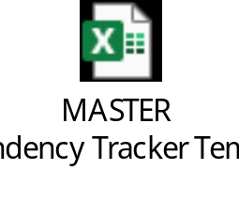
1. Point to Point Dependencies – Within Programme (example data)
Set-up:
Step 1 (Discovery & Inception):
GETTING RT Lead documents the dependencies they have on other Release trains / client programmes.
Step 2 (Discovery & Inception):
GETTING RT Lead aligns with the GIVING Release Train Lead(s) / Other Programme Lead(s) on timeline, marking the date of the ‘Handshake’.
Step 3 (Delivery):
Daily Scrum calls to unblock issues. Weekly reviews of coming due dependencies with RT Leads, updating status and agreeing corrective action.
RT# | RT Lead | Release train GETTING the Dependency | Release train / Entity GIVING the Dependency | Required by Sprint (Start of…) | Required by Date | Dependency ID | Dependency Description | Handshake Date | Status
1 | Joe Bloggs | RT01-Claims Center | PGM01-Underwriting Workbench Pgm | S1-Build | 03-Apr-23 | RT01-PGM01-01 | Dependency to supply signed off Technical Design Documentation (TDs). | 01-Feb-23 | Forecast Delay Plan to Recover
1 | Joe Bloggs | RT01-Claims Center | PGM02-Aptian Workflow Pgm | S3-Elaboration | 01-May-23 | RT01-PGM02-01 | Dependency to attend and sign-off against Requirements during S3 Elaboration for input into S3 Build. | 01-Feb-23 | On Track
2 | Jane Bloggs | RT02-Data | PGM03-Policy Admin System | S2-Build | 01-May-23 | RT02-PGM03-01 | Dependency to supply signed off Integration Design Documentation for S2 Build. | 01-Mar-23 | On Track
2 | Jane Bloggs | RT02-Data | PGM04-Data Transformation Pgm | S3-Build | 29-May-23 | RT02-PGM04-01 | Dependency to supply signed off Data Dictionary in time to support S3 Build. | None
Reporting:
Release train | Count of Handshakes Missing
2 | 1
6 | 34
9 | 8
12 | 3
13 | 2
14 | 27
19 | 1
(blank)
Grand Total | 76
Count of Dependencies Due
GETTING Release train | 06/03/23 | 10/03/23 | 13/03/23 | 17/03/23
2 |  | 2
4 | 1 |  | 4
7 |  |  |  | 1
10 |  | 1 |  | 13
14 |  |  | 1 | 10
19 |  |  |  | 1
Grand Total | 1 | 3 | 5 | 25
An example of the reporting produced to show the number of handshakes that are outstanding.
This is published to drive RT Leads to complete handshakes so that there is a commitment made by the GIVING Release train to the GETTING Release train.
An example of the reporting used to show the number of dependencies coming due.
This is published to drive RT Leads to continually manage their dependencies, ensuring they are on track, and taking appropriate actions where required to avoid impact of any delays.

Slide 78
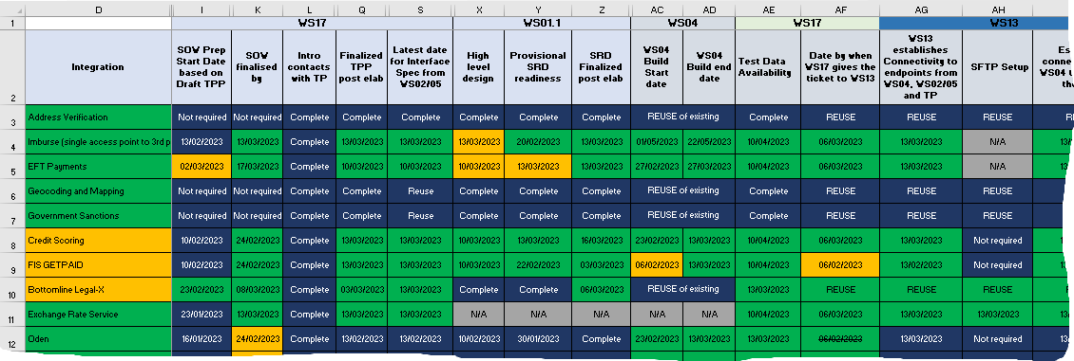
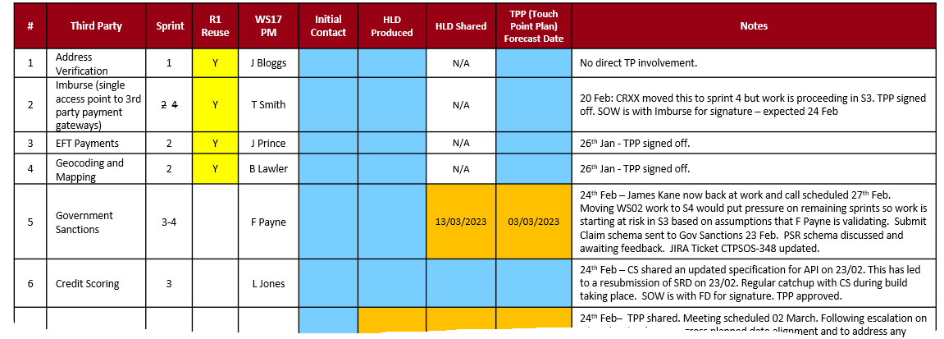
2. Complex Dependency Chains – with 3rd Parties (example data)
Set-up:
The chain of Proj/Prog is listed out.
All activities are listed out in the order they need to take place.
The dates by when each activity needs to be completed by each Proj/Prog and for each supplier is documented and forms the input to the TPPs.
Reporting:
A weekly report showing the status of each supplier integration is produced and reviewed with the programme leadership to ensure quick decisions / corrective action is taken for ‘at risk’ dependencies.
This is crucial within an agile environment to drive delivery in complex multi Proj/Prog & supplier environments.

Slide 79
Catalogue of Thirdparty dependencies across phases
Sprint Phase
Cap Dependency detail
Cadence Touchpoint
Third Party
Roles: Release Train Leads, Architects, Technical SME
Align integrations in-scope for sprint
Transaction details of integration
Timeline dependency for service availability
Requirement of third-party support
Environment and connectivity detail
Sprint planning meeting
Requirements workshops
Playback sessions
Confirmation of dependencies can be met
Service availability schedule
Highlight challenges with environment
Elaboration & Design
Roles: Release Train Leads, Architects, Technical SME
Roles: Release Train Leads, Architects, Technical SME
Service availability, connectivity and stability
Service developed to requirements agreed
Service defect fixes and ETA
Test data requirements
Defects, data validations and environment issues resolved in same day
Access to JIRA for all incidents
Defect triage call
Weekly twice touch point meetings
Retrospective meetings
Test data supply
Support and sign-off test case validations
Access to environments
Environment and Escalation support
Support window (Timings in a day that the service is available to be informed
Any maintenance/downtime schedule to be shared
Development
Roles: Release Train Leads, Architects, Technical SME, Test leads
Roles: Release Train Leads, Architects, Technical SME
Service availability, connectivity and stability
Service defect fixes and ETA
Test data requirements
Defects, data validations and environment issues resolved in same day
Access to JIRA for all incidents
Defect triage call
Weekly twice touch point meetings
Test data supply
Support and sign-off on business flows
Access to environments
Environment and Escalation support
Support window (Timings in a day that the service is available to be informed
Any maintenance/downtime schedule to be shared
Stabilisation
Roles: Release Train Leads, Technical SME, Test leads

Slide 80
Third party response time
Phase | Dependency | Expected response time
Elaboration & Design | Sample file format for inbound and outbound feeds | By start of the sprint
 | Third party test scenarios which are required for providing sign-off | Week 1 of the sprint
 | Document Third party test scenarios (If any) which are required for providing sign-off | 1 Week prior to sprint start date
Development | Environment availability, stability and access | 1 working day
 | Test Data needs | 1 or 2 working days
 | Sign-off on Data outbound feeds as per sprint plan | 5 working days after the test completion
 | Data validations | 1 working day
 | Defects turnaround time | Critical - 2 Hours, High - 1 day, Moderate - 3 days, Manageable - 5 days
Stabilization | Environment availability, stability and access | 1 working day
 | Test Data needs | 1 or 2 working days
 | Sign-off on Data outbound feeds as per sprint plan | 5 working days after the test completion
 | Data validations | 1 working day
 | Defects turnaround time | Critical - 2 Hours, High - 1 day, Moderate - 3 days, Manageable - 5 days

Slide 81
Metrics

Slide 82
Tracking Sprint progress
Each Sprint to have a daily reporting through JIRA dashboards to track velocity numbers by story or story points and other test metrics as applicable. The dashboard designs will be agreed between the RTLs and programme governance teams. Following are some of the standard metrics that are proposed for tracking progress
SPRINT - VELOCITY by stories
User story burn down tracking. Planned vs Actual on a daily basis
SPRINT - VELOCITY by story points
Story points burn down tracking. Planned vs Actual on a daily basis
Team to take up corrective action for any lag in the burn down
SPRINT PROGRESS
User stories progress by Release Train through life cycle (dev vs test)
Reports made available via JIRA dashboards
Team to take up corrective action for any lag in the burn down
Burndown charts by Release Trains
Burndown charts by Release Trains
RELEASE – VELOCITY
User story or story points burndown. Planned Vs Actual for full release
Reports made available via JIRA dashboards
DEPENDENCISES TRACKING
A mechanism to be developed to track external dependencies and delays
TEST METRICS
Coverage metrics – Requirements, User story, Business process during stabilisation
Test metrics – Test execution burndown
Defect metrics – Defects by severity/priority, by Release Train, over time, rejection

Slide 83
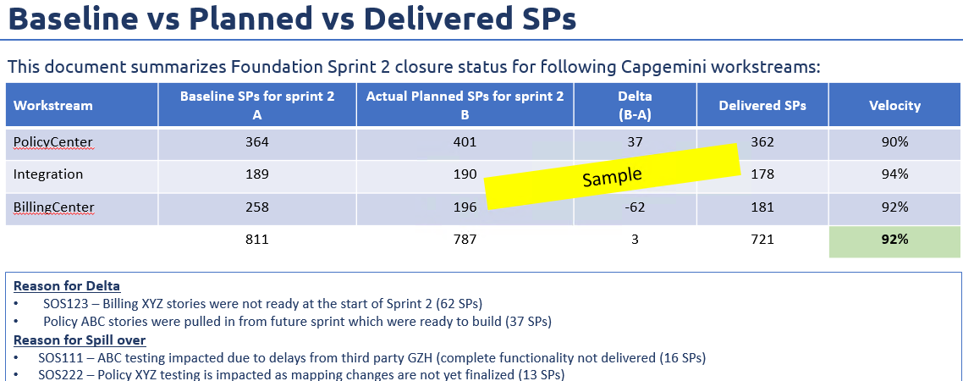
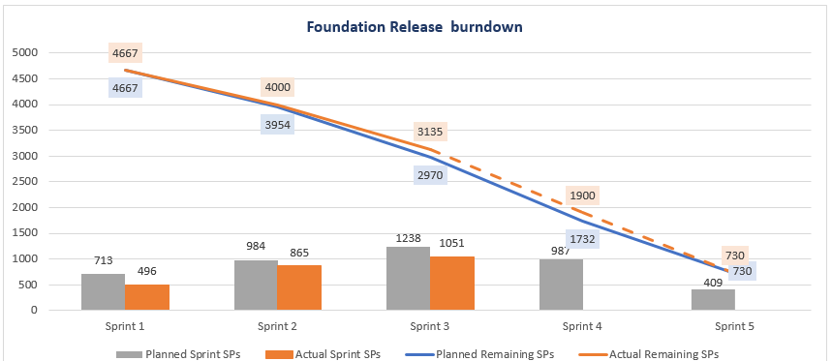
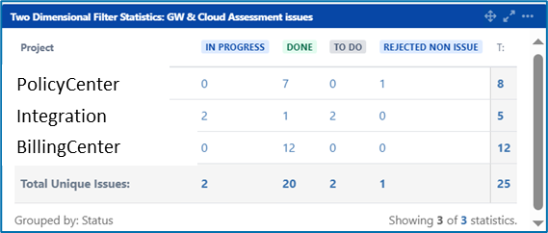
Sprint Closure pack
A Sprint Closure pack will be presented to Beazley for each sprint approximately a week after the sprint is formally closed in JIRA. Assuming sprint X closes formally in JIRA on a Monday, the closure pack will be published by Friday same week.
Sprint Closure Pack contents: All data extracted from JIRA
  Baseline vs Planned vs Delivered Story Points
  Sprint closure stats & Deferred stories data
  Overall active defects
  Guidewire Cloud assessment status
  Release burndown – Orig vs Current
  Potential risks for overall Release plan due to delays (if any)
  Status of DOD, DOR & Retrospective links
  Guidewire conformance summary for user stories
Sample Summary in the Closure Pack showing Planned Vs Delivered stories
Sample Release Burndown
Sample JIRA board showing Guidewire Assessment observations

Slide 84
Appendix

Slide 85
Lessons learned from UWWB Project
General
New/change-in scope to be channelled through Change management process
Environment
Environments to be in place before Build phase
JIRA Hygiene
Access to Beazley building & floor to work along with GPAS & Billing team
Logistics and Access
Adhering to DOD & DOR for moving story to next stage/status
Direct access to Business SMEs by Cap Bas to clear any gaps in requirements
Misalignment between the requirements shared by the Beazley BAs vs Beazley Architect
E2E flow demos to be provided by the business that includes third party systems
Plan test data creation for Testing Team in advance to avoid test execution delay
Adhering to Sprint DOD & DOR to start the sprint in Jira
Having one workflow scheme configuration across Release trains within the programme
Updating ETA & latest status for dependent stories/task in Jira on regular basis
Adding latest comments to the issue as & when there are changes
Linked Issues to be effectively utilized esp. when dependency is identified
Access to GPAS & Billing team’s calendar to plan meeting better

